Slide 1



Solution
Telematics. Payments. Commerce.
for
Dairy Industry

Slide 2










About Us | Optimising Logistics Tracking and Management across Industries
Who Are We
Our USPs
Our Clientele
India's
leading logistics tracking platform
3000+ fleet owners
Nearly 170,000+
vehicles on platform
Backed by Sequoia Capital – one of the world’s largest tech venture fund
Best-in-class hardware with 98%+ uptime
Service and support network across 350+ locations
Client engagement by Business Consultants with Industry expertise
Robust and customizable software platform

Slide 3
Success Stories | Mother Dairy
“
Mother Dairy
increased visibility, optimized TAT & reduced pilferages
→ Client wanted to gain visibility of all movements & understand the root-cause of sub-optimal logistics movement which was leading to high operational costs
→ LocoNav provided state-of-art telematics solution for the entire fleet
→ Visibility of all procurement vehicles increased by more than 80%
→ LocoNav’s automated trip based module helped Client reduce extra cost, with monthly billing being completely dependent on the total KMs driven during the daily trips.

Slide 4
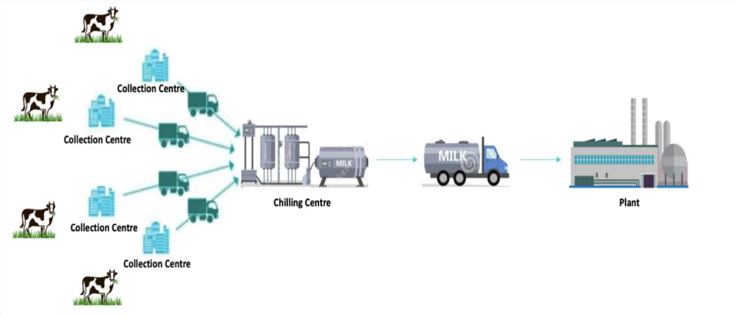







Need for Tracking | Dairy Industry
Distributor
Distributor
Distributor
- Unnecessary stoppages
- - Inefficient route planning
- - No visibility of Trips
- - No sense of ETA
Unloading time at Plant
Distributor
-
- No Sense of Pilferages
PRIMARY MOVEMENT
SECONDARY MOVEMENT
DISPATCH MOVEMENT

Slide 5
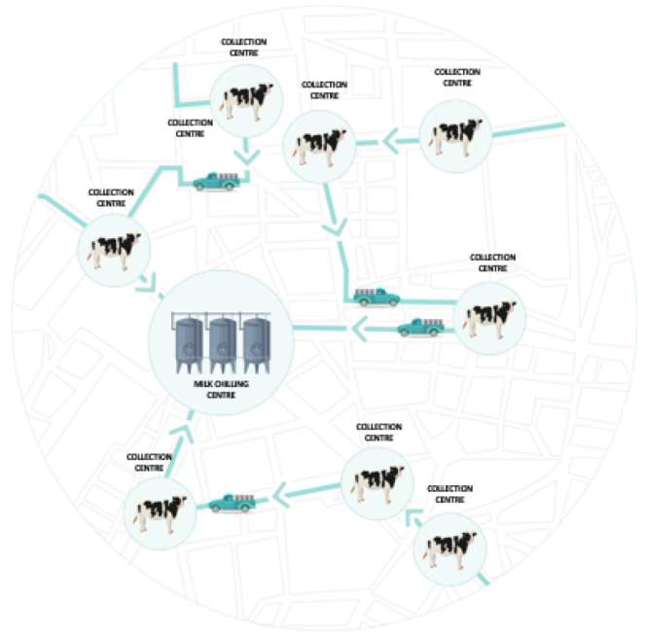
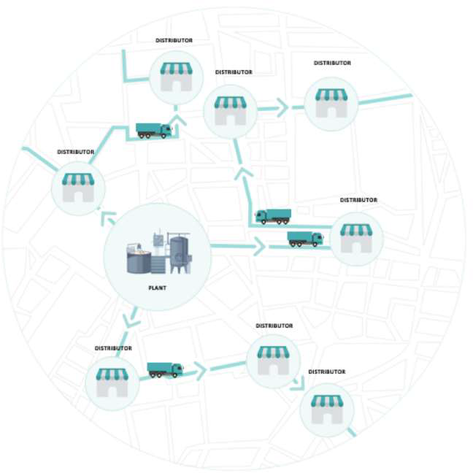
Need for Tracking | Primary & Dispatch Movement
COLLECTION CENTRE
Waiting time at Collection Centre/
COLLECTION CENTRE
Distributors.
Comparative Analysis of In Time/Out Time of Vehicles against the Daily Target Times for each Collection Centre/ Distributor.
Alerts for vehicle entry and exit at each Milk Chilling Centre.
Automated trip based monitoring along with predictive ETA, total Kms driven during the trip and unwanted stoppages.
Route Deviation Alerts.
Monthly Billing is reconciled depending
COLLECTION CENTRE
MILK CHILLING CENTRE
COLLECTION CENTRE
COLLECTION CENTRE
on the total usage (total distance travelled during duty) of the vehicles coming from the daily trip report.

Slide 6
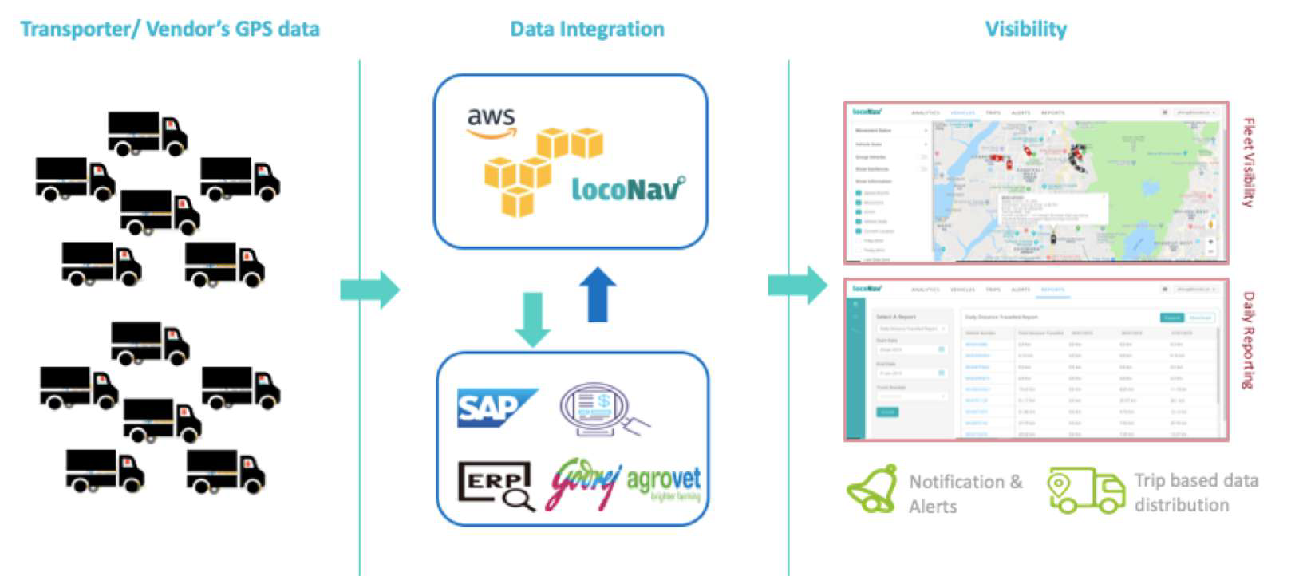

Logistics Analytics | Data Aggregation, Visibility, Reporting & Integration

Slide 7

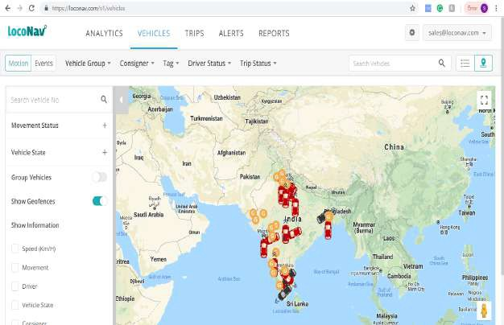

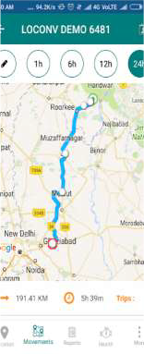
Benefits | Tracking and Visibility
→ Live Vehicle Tracking – have a hawk-eye view on all vehicles that are plying for the company
→ Route Optimization– Identify the most optimal route touching all the nodal pickup points and drop locations along with route deviation alerts
→ Trip Based Monitoring – have visibility of all trips bifurcated into on-time, delayed, completed and unsuccessful.
→ Real-time Alerts – Get notified of various event types (geofence entry/exit, stoppages, tampering, overspeeding, driver behaviour related# etc)
→ Nearest Vehicle Locator– with the help of our nearest vehicle locator, track and get ETA information for any nearby vehicle in cases of emergency/ vehicle breakdown.
→ Idling– Identify cases where the driver has engaged in suspicious activity such as idling, unplanned stoppages, route deviation etc.

Slide 8

Optimization | Cost & Operations
→ Turn Around Time – Optimize TATs using recursive analysis. Identify and take action against repeat defaulters
→ Insightful Reports and MIS – Comprehensive reports and analysis at various levels; daily, weekly, monthly, region wise, state wise etc. E.g.- Total distance travelled, stoppage reports, trip reports etc.
→ Driver Performance – Insightful reports & analysis on no. of trips undertaken and their status – completed, delayed, unsuccessful etc. Incentivize or penalize based on weekly/monthly performance to ensure that a higher standard of operation is achieved
→ ERP Integration – Update trips from the ERP system directly and seamlessly onto the LocoNav platform on a real-time basis to ensure fully automated trip monitoring

Slide 9
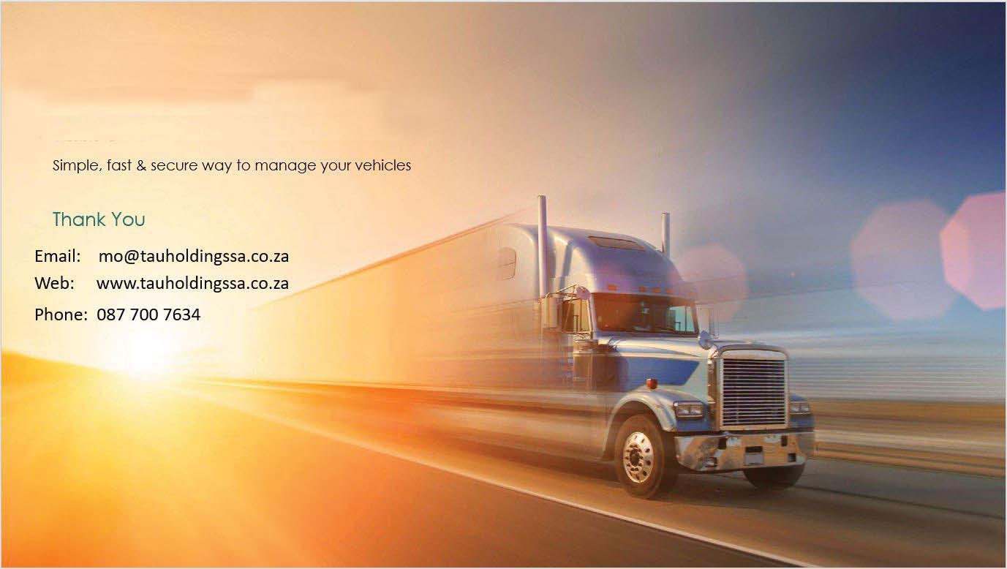
Simple, fast & secure way to manage your vehicles
Thank You
Email: mo@tauholdingssa.co.za
Web: www.tauholdingssa.co.za
Phone: 087 700 7634

