Slide 1

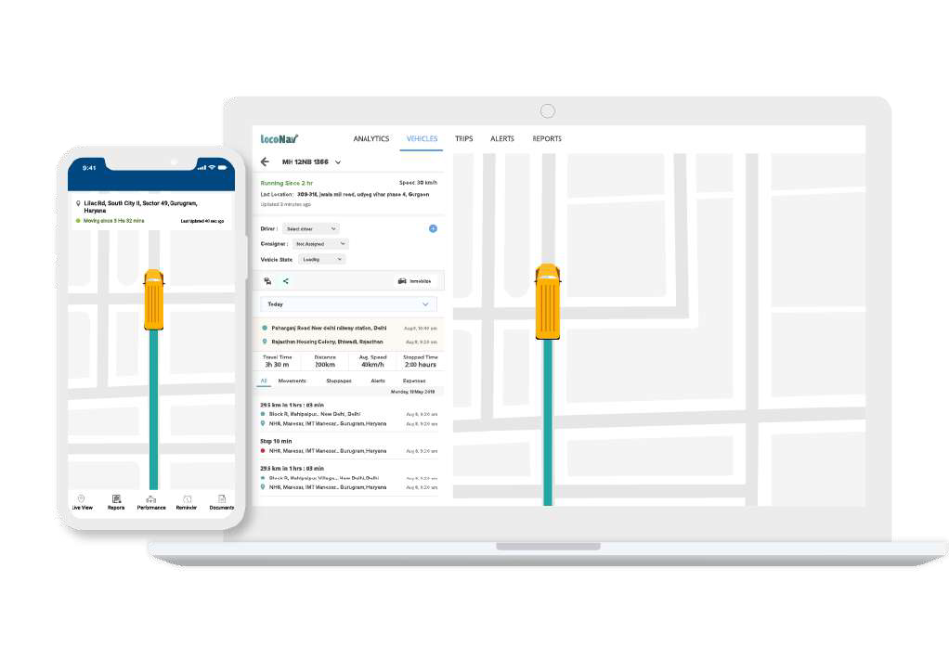






Smartest Fleet Tech Services and Solutions Ecosystem
Seamless API Integration
ADAS +
Driver Rating
Fuel Monitoring &
On-Board Diagnostics
15+ Countries Served
400k+ Assets Under monitoring

Slide 2





















Who we Work With
Prestigious Clientele
Advisors & Investors
Ajay Agarwal
Partner @ Bain Capital Ventures Board Member @ Fourkites, Sendgrid, etc.
Salil Deshpande
General Partner at Uncorrelated Ventures
MD @ Bain Capital Ventures
Sanjay Rohatgi
Ex MD @ Cisco India
Ex APAC Head @ Symantec Asia Lead @ NetApp
Jai Shekhawat
Founder CEO of Fieldglass (acquired by SAP
$1B) Board Member @ Fourkites, Signal, Fleetcomplete
Anjali Joshi
Ex VP-Product @ Google
Serves on the Board of & advisor to leading techonology companies
Mark Licht
Founder of Teletracituran (Nasdaq listed) & Siigma One. Serves on the board of and advisor to leading Fleet Tech companies
Shubhankar B.
Partner @ Foundamental VC
Ex Venture Partner @ Kae Capital
Manik Gupta
Ex CPO @ Uber
Ex-Product @ Google Maps
Shailesh Lakhani
Partner & MD @ Sequoia Capital India
Anand C
Ex CPO Airtel, Snapdeal, Ex Facebook EVP @ Five9

Slide 3





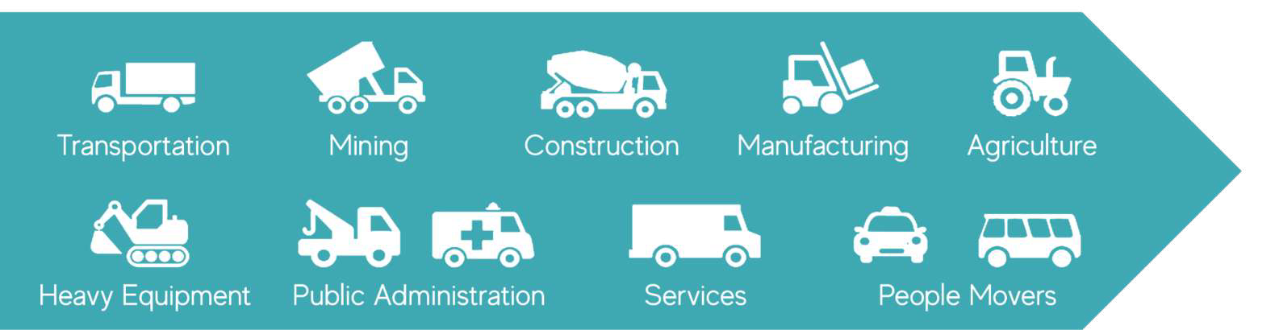
Industries we are Serving
400000+ Vehicles / Assets
Live in 15+ countries
100000+ Zip
Codes served
Seamless API Integration
2200+ devices integrated & counting
60000+ Business Partners

Slide 4

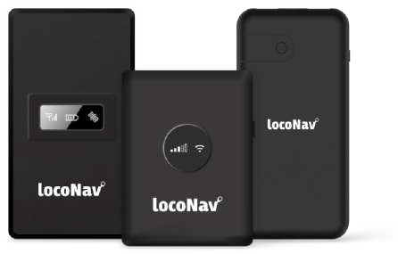























Supported Hardwares
Compatible with 2200+ IoT Devices & Sensors
Premium Hardware Partners

Slide 5
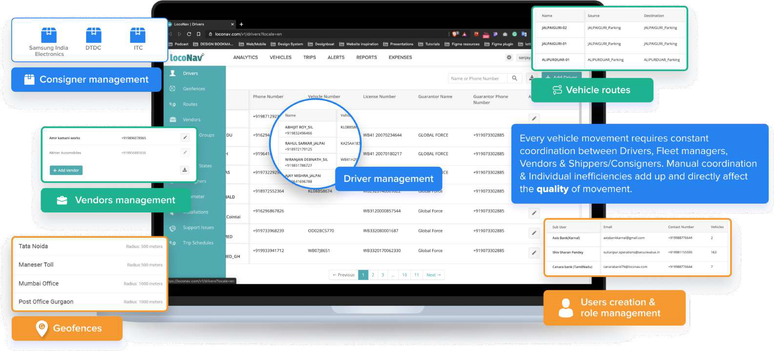
Setting Up The Platform

Slide 6
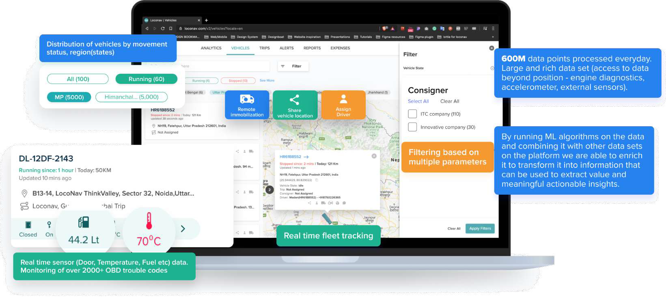
Visualize Real-Time Fleet Performance

Slide 7
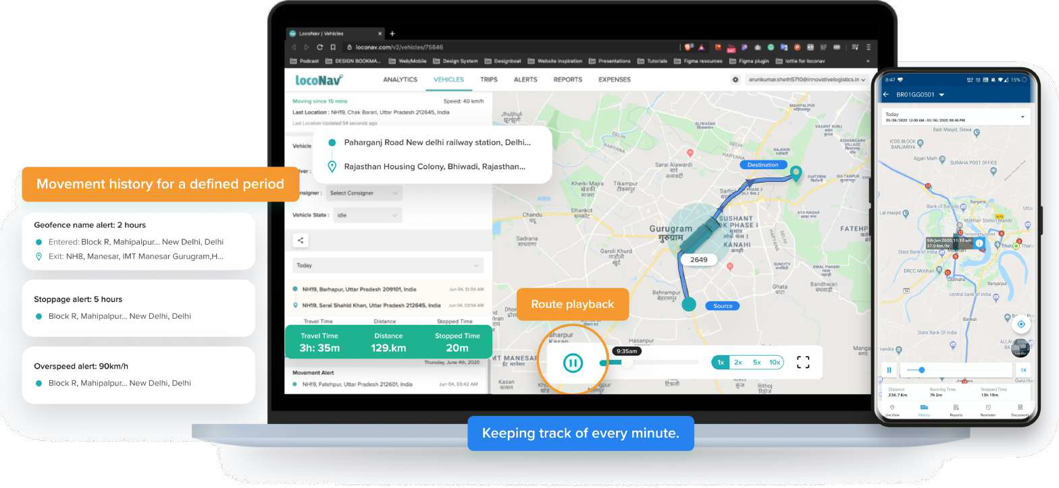
Drill Infinitely Into Your Vehicle Data

Slide 8
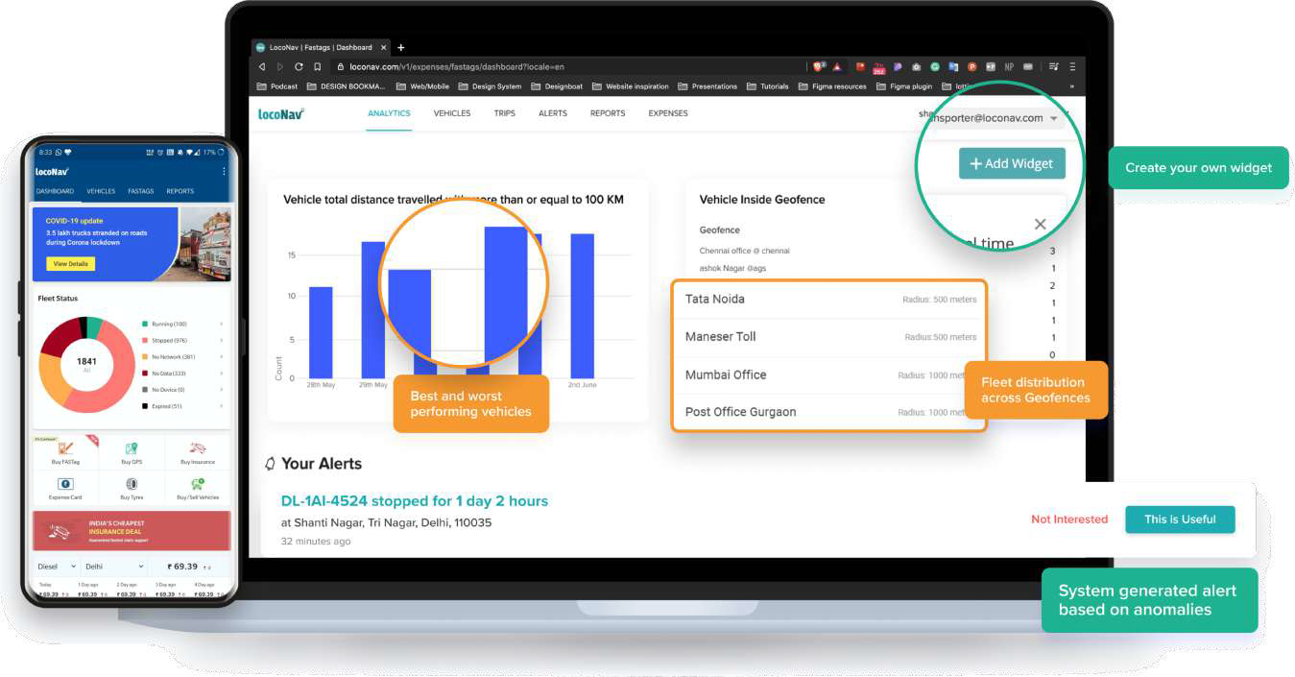
Personalized Dashboard

Slide 9
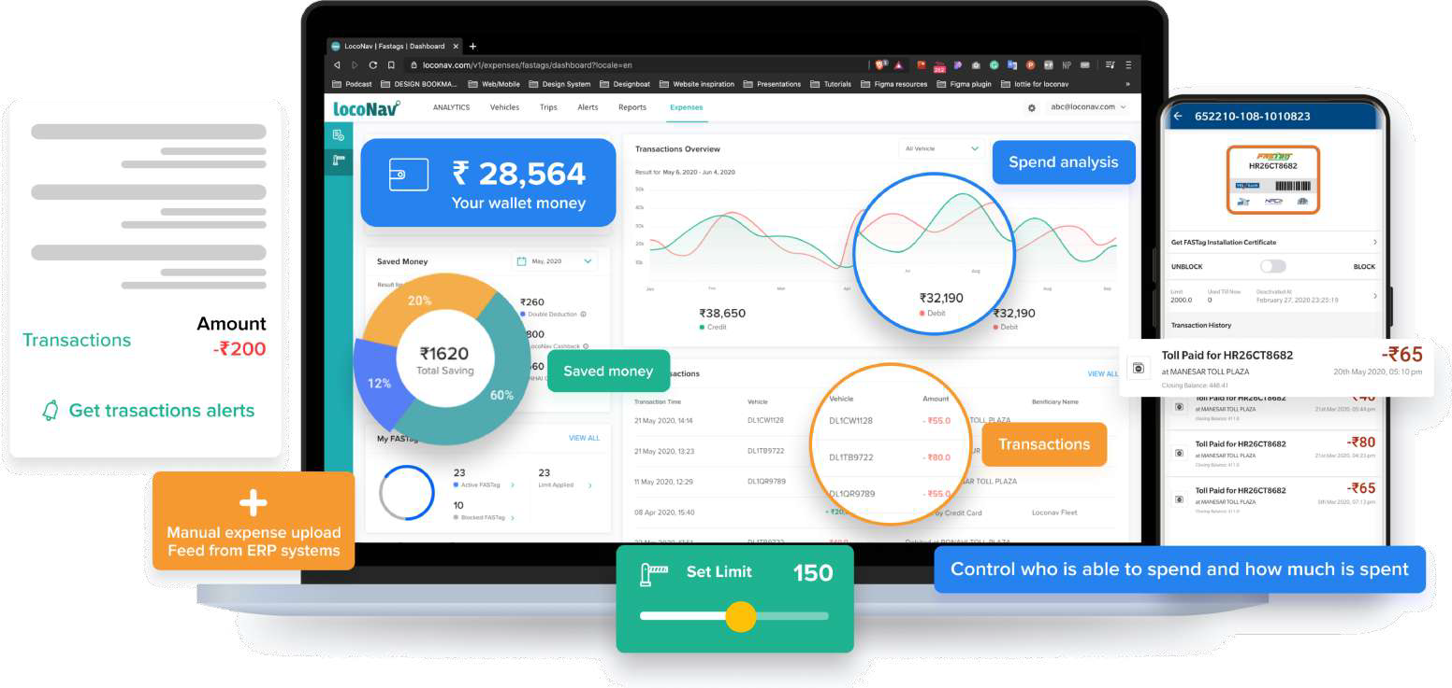
Unified Payment Wallet & Digital Reconciliation

Slide 10
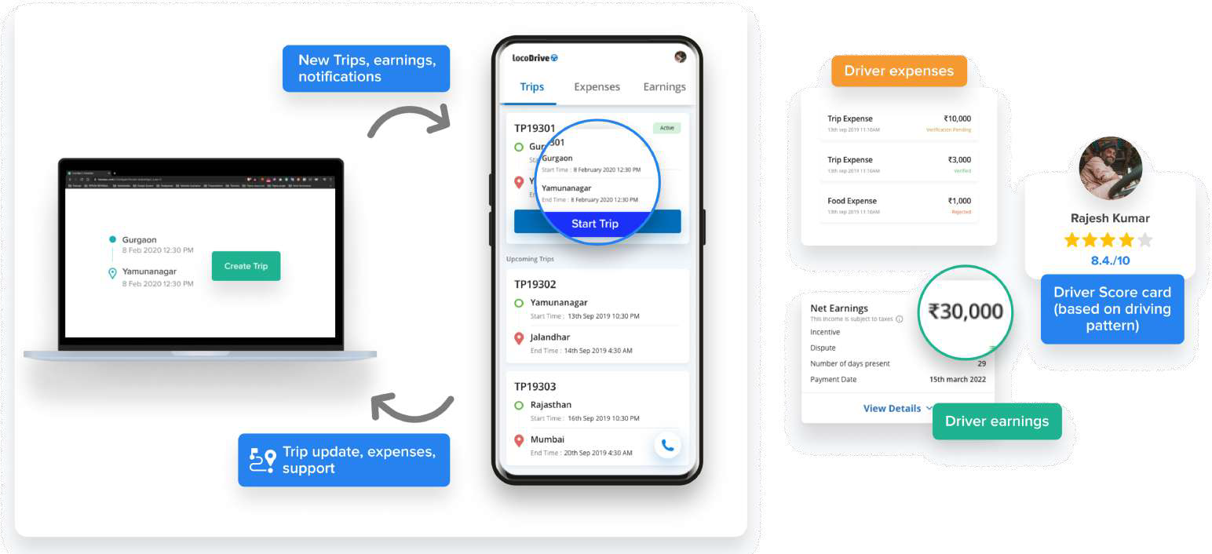
Driver Side Provisions

Slide 11

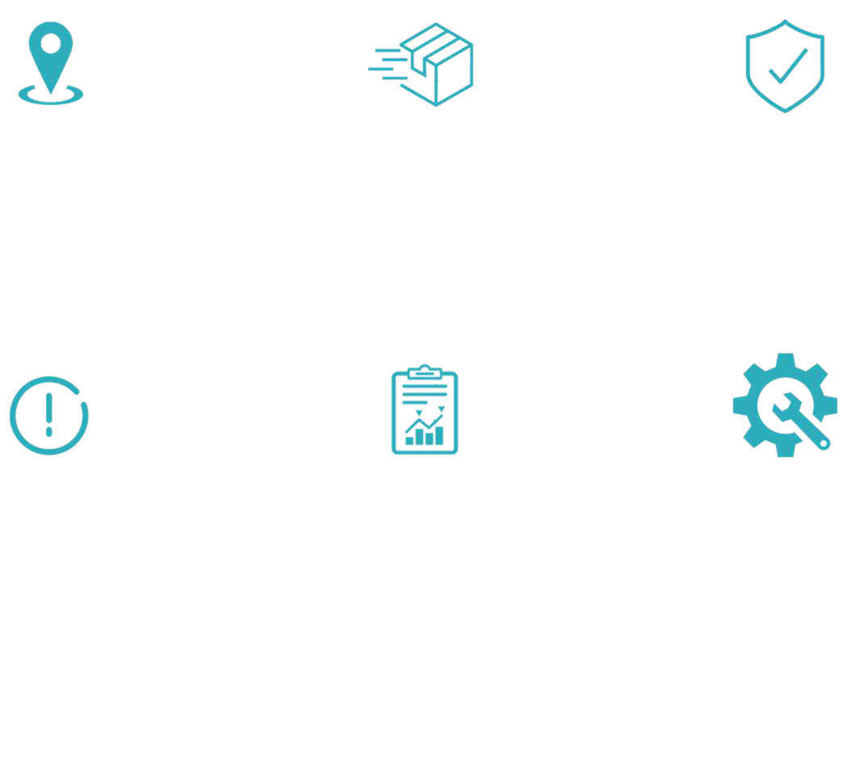

Salient Features & Benefits
Live Asset Tracking
Shipment Tracking
Identify theft / pilferage
Have a bird-eye view on all assets that are plying for the company
Track Visibility of all outbound shipments via advanced tools & identify various statuses
With the help of our intelligent algorithms, track and identify the sources of pilferages
Real-time Alerts
Reporting & Compliance Management
Expense Management
Get notified of various event types (Geofence Entry/Exit, Stoppages, Tampering, Delays, etc)
Identify the defaulters – The assets unavailable at the allotted spots during the prescribed times. Thus, minimize the inefficiencies
Control over drivers and vehicles Expenditure by monitoring
cash.
Also, Go Cashless

Slide 12

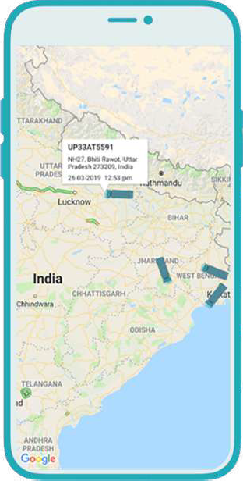

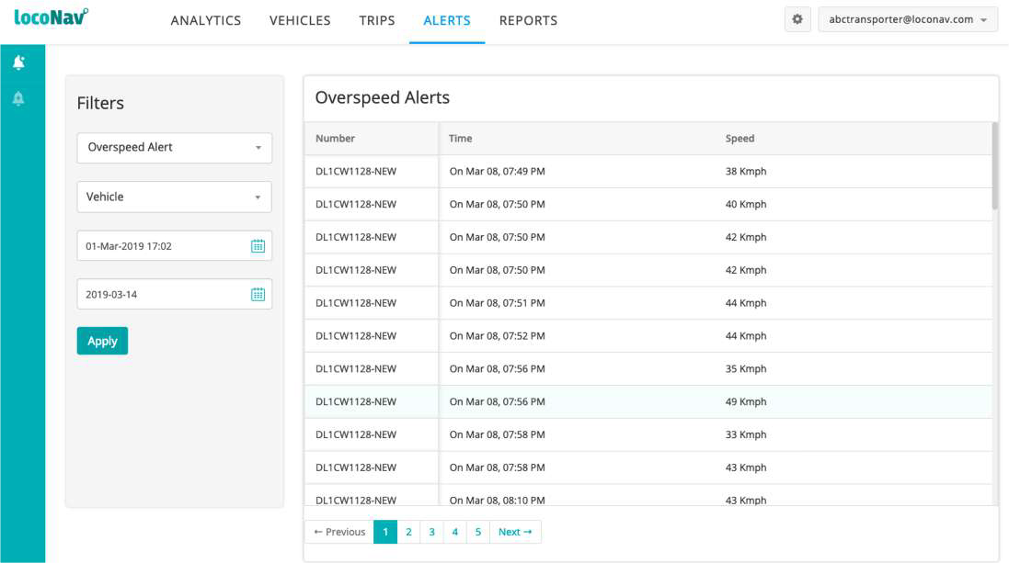
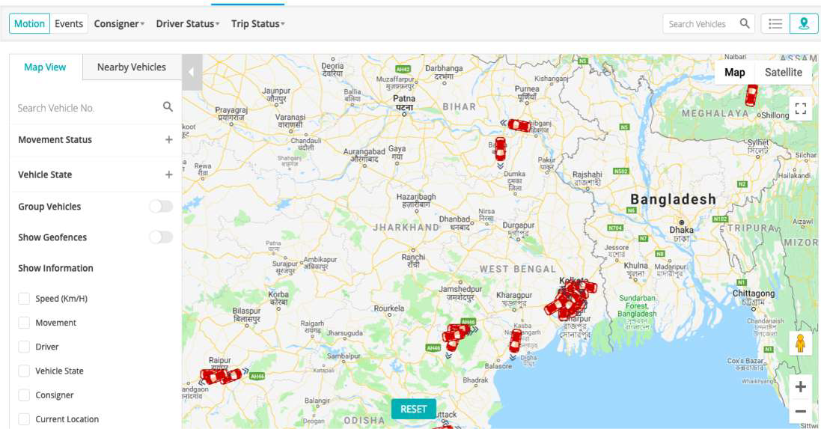
360° detailed view
Track movement of any vehicle
Hawk-eye view of the entire fleet
Analysis of the routes/traffic/idle time
Customizable time and date settings

Slide 13

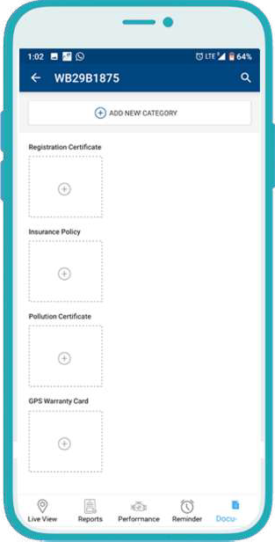

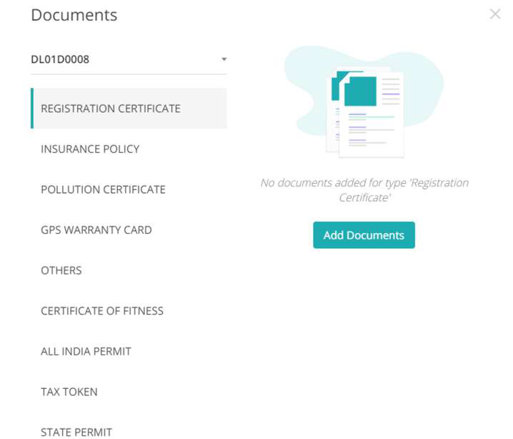
Managing Documents, Compliances & Records
Maintain an online database of vehicles Easy Upload of Documents via app
View entire fleet’s requisite legal permits Automated Reminders for renewal on phone/e-mail

Slide 14



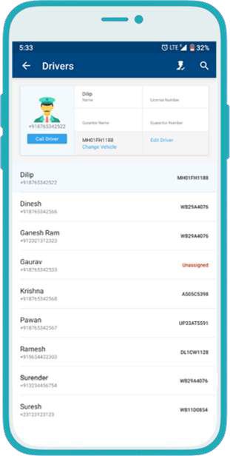
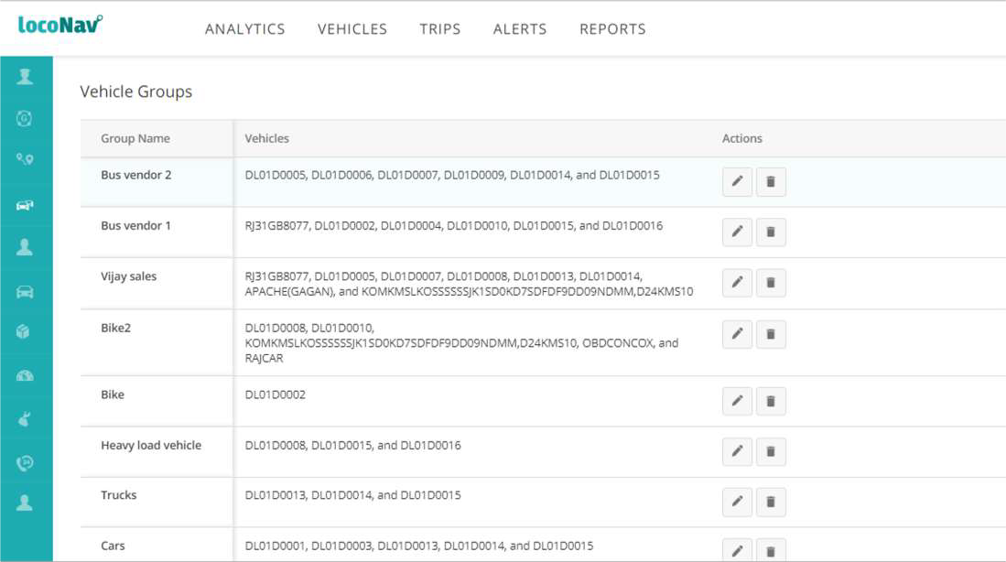
Managing Drivers and Transporters
Assign the drivers to vehicles
Group vehicles as per usage
Make edits and changes in bulk
Compare driver and vendor performance

Slide 15



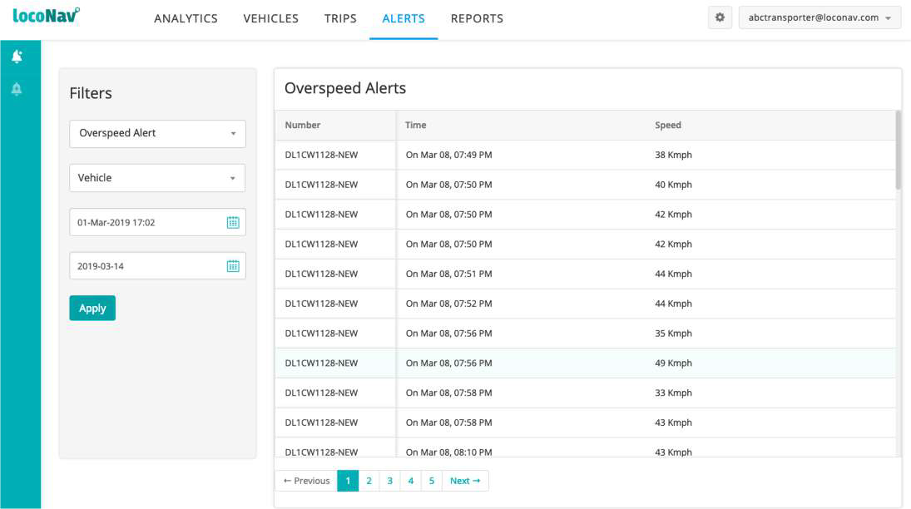
Real Time Alerts
A log of all actions completed by a vehicle
Entry or exit alerts through a preset geofence,
Planned or unplanned stoppages during trips
Any attempts made for tampering the devices
Sort by alert type, vehicle no. or time period
Receive Alerts via web, app, SMS or e-mail

Slide 16


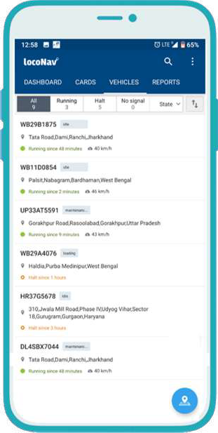
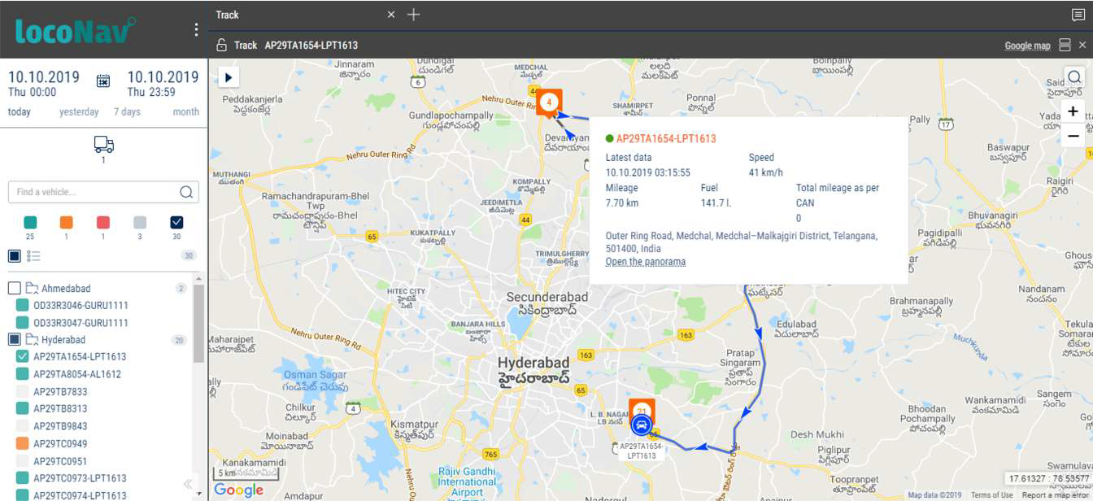
Real-Time Fuel Updates
99.5% accurate fuel monitoring
Fuel theft/pilferage detection
Real-time fuel levels
Fuel economy/mileage updates and tracking

Slide 17


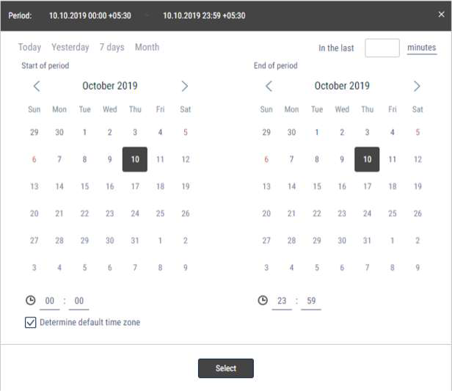

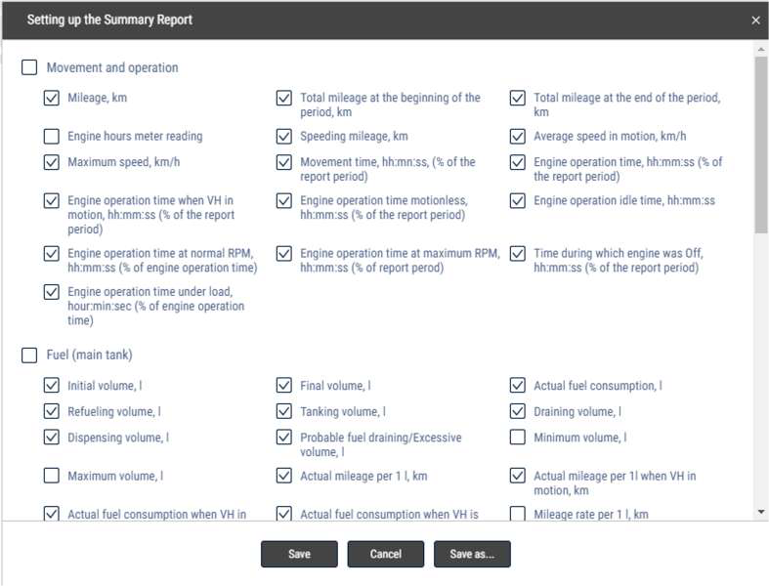
Customizable Reports
Take control over the data that is relevant to you and your business, and manage all the information your way

Slide 18


Optimization | Cost & Operations
Turn Around Time
Optimize both ‘In-Plant’ & Outbound movement using recursive analysis.
Identify and take action against repetitive defaulters
Distance Correction
Create a repository of vendor/clients locations & eliminate cases where the distances in the ERP system is leading to unnecessarily high payouts
Transporter Performance
Insightful reports & analysis on no. of trips undertaken and their statuses. Incentivize or penalize based on their performances to ensure a higher standard of operations
Vendor Performance
Identify vendor performance via reports generated using trip related metrics such as completed shipments, unsuccessful shipments, deviation, dealer detention etc.
Increased Trip Frequency
Provide visibility to vendors/clients along with the ETA to ensure the detention time is reduced and thereby facilitate a quicker TAT
Demand Forecasting
Daily report of vehicle status for precise planning to aid in increased serviceability to facilitate greater sales volumes and thereby capture a larger market share

Slide 19







ADAS – Video Telematics
Driver Behavior Monitoring to prevent accidents
Locate, track, and manage your vehicles in real time
Driver’s Scorecard with Performance Report
Connect with dual facing dash cams
Prevention from False and Fraudulent Claims
Improvement in Driver Engagement and Retention

Slide 20

Secure your Vehicle with Device Peripherals
Vehicle Immobilizer Remotely Immobilize the vehicle
using your dashboard
SOS Panic Button
To alert the respective authorities
In case of any threat
Trip Button To manage trips as per your
preferences
Door Sensors
Detect every time a door is locked or unlocked
Fuel & Temperature Sensors Detect the fuel level & temperature of the vehicle container using Bluetooth sensors
2 Way Communication
A speaker & mic installed along with the panic button for emergencies
Digital Padlocks & Key Less Entry Secure your goods with remote-locking
enabled peripherals

Slide 21








LocoDrive
Get granular visibility of driver & vehicle performance
AI based trip and downtime insights
Eliminates complete need for people to keep a tab on the tracking platform
Incentivize drivers based on performance
Up to 2x decrease in costs and 30% reduction in running expense
Automate expense control and integrate seamlessly

Slide 22

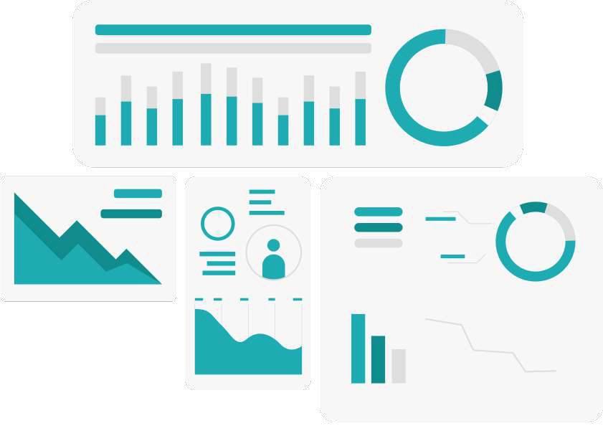




LocoInsure
Manage Documents
Manage insurance documents and auto alerts of expiry.
Manage Claims
Manage claims support from LocoInsure dashboard
Comprehensive Visibility
Comprehensive Digital visibility of all available options
Lowest Price
Lowest priced offers to the customers and the clients
Forefront of Insuretech
Risk visibility and driver performance assessment data to Insurance Carriers, allowing use of pay per use and performance based pricing.

Slide 23
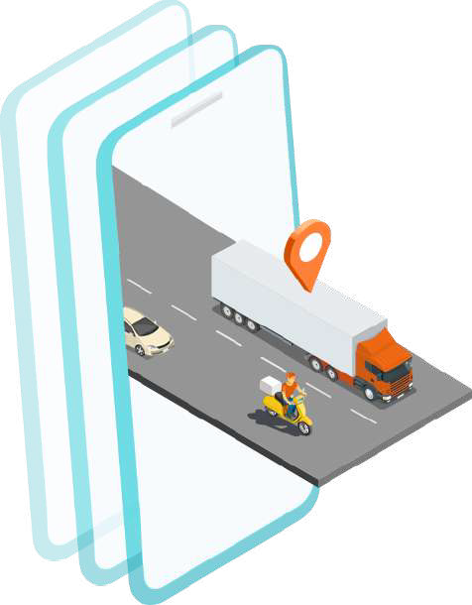



Value Proposition of Telematics for Financial Institutions
Using telematics data, we will be able to provide various benefits from both Risk as well as Business perspective.
The benefits can be outlined as follows:
Consumer Profiling
Usage based Credit Ratings
Demand Analysis
Cross Selling Products
Cross Sell Opportunities
Demand Forecasting
Risk Assessment & Mitigation
Fleet Utilization & NPA Reduction
Increased Security and Control
Real-time dash cam visibility

Slide 24



Risk Assessment Metrics & Data Points
Through the following data captured through LocoNav Telematics, we will be able to provide significant insights into the workings of a vehicle (and subsequently the Fleet Owner) which will be highly beneficial to a financier from a Risk perspective.
Fleet Utilization Index - Relative to the Market ; Distance traveled per vehicle on a daily/weekly/monthly basis
Routes Taken - Distance traveled in duty compared to the total distance traveled (Loaded vs unloaded)
Driving Index - Relative to industry standard (other Drivers on the Platform)
Expense Index - Expense incurred per KM relative to industry standard (other similar Vehicles on the Platform)
Payment cycles of Customers and their Shippers (estimated size of Working Capital invested)
Non-Availability of Drivers (potential revenue lost) - Clearly identify non-utilized (Zero km traveled) vehicles
Number of Accidents - Subsequent potential revenue loss
Demand Trends and Forecasts (specific to industry, across the platform) – understanding market trends
Vehicle Quality Index – Monitor how well vehicles are maintained across the board through usage and behavior analysis

Slide 25


Increased Security & Control
Exercise a greater control over the Customer through Telematics and Payment Instruments, and take proactive security measures
Remote Immobilization - Single click security measure for EMI defaulters; Repossess vehicle if required
Identify Restricted Movement - Take action on non- utilized vehicles beforehand
Device Tampering Alert - Clear indication of suspicious activity and potential defaulting
Ability to limit/ block payment instruments to
certain Merchants
Consumer Profiling
With the help of data such as telematics, financial transactions, payment receipts and more through LocoNav, we will be able to segment the customer base for a better understanding
Visibility of Shippers that the consumer is plying for – analyze and record payout trends, penalties levied etc.
Business Hygiene/ Visibility of Profitability (estimated)
Fleet Size & Fleet Type
Current Financiers & Insurers
Working Capital

Slide 26

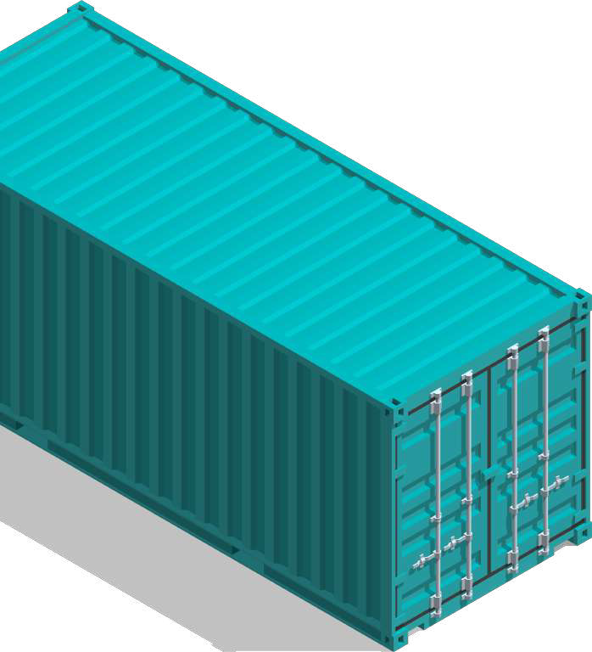





Benefits to Freight Marketplaces
System integrator through data aggregation
Single point of integration with LocoNav’s system integrator
Access to LN onground partners - worldwide reach
Leverage the wide ranging service network across the globe
Device agnostic integration
No hardware related constraints - 2200+ devices & counting
Plug and play via API
Flexible & seamless API integrations with two-way data flow
Future ecosystem partner
Cross-sell freight platform with access to LocoNav userbase

Slide 27




Benefits to ERP vendor
2-way integration of telematics & ERP products
Ability for user to work with a single interface while leveraging the power of the LocoNav platform. Integrate telematics data for a hawk- eye view on operations
Easy API integrations
With highly flexible & open APIs, integrate with ease
Alternate revenue source
Upsell the LocoNav product to existing ERP customers and add another revenue stream to your business
Device agnostic
With over 2200 devices already integrated, let go of all hardware related constraints with seamless plug and play

Slide 28






Benefits to end customer of ERP
Unified platform
Move away from multiple platforms for a holistic 360° view on a single dashboard
Save man hours & reduce operational cost
Use the power of ERP and Telematics to automate tasks and processes, saving time and costs
Vehicle & fuel monitoring
Crack down on violation and thefts with a state-of- the-art telematics platform
Comprehensive insights
Combine telematics and ERP data for a detailed analysis
Optimize fleet utilization
Track fleet performance & reduce TAT with telematics backed trip data

Slide 29

Thank you
Email: mo@tauholdingssa.co.za
Web: www.tauholdingssa.co.za
Phone: 087 700 7634

