Slide 1



Tracking. Analytics. Visibility.
Solutions for Schools

Slide 2

Our Industry Specific Offerings - Schools
Analyzing the driving behavior and enabling the assignment of drivers and vehicles.
Maintain a database of all the documents related to the driver and the vehicle.
Managing Drivers
And Helpers Records
Managing vehicle
Records
Provide visibility to the
concerned guardians (school teachers and parents) over
school buses.
Sort the vehicles as per the areas assigned or as per the transporter/ vendor
Managing
Transporters
Daily Route
Monitoring
Reports and
Alerts
Managing Boarding Points
Real time reports can be generated and various alerts/ notifications can be sent via SMS or E-mail
Set up routes and align various pick ups or drops.
Cement

Slide 3

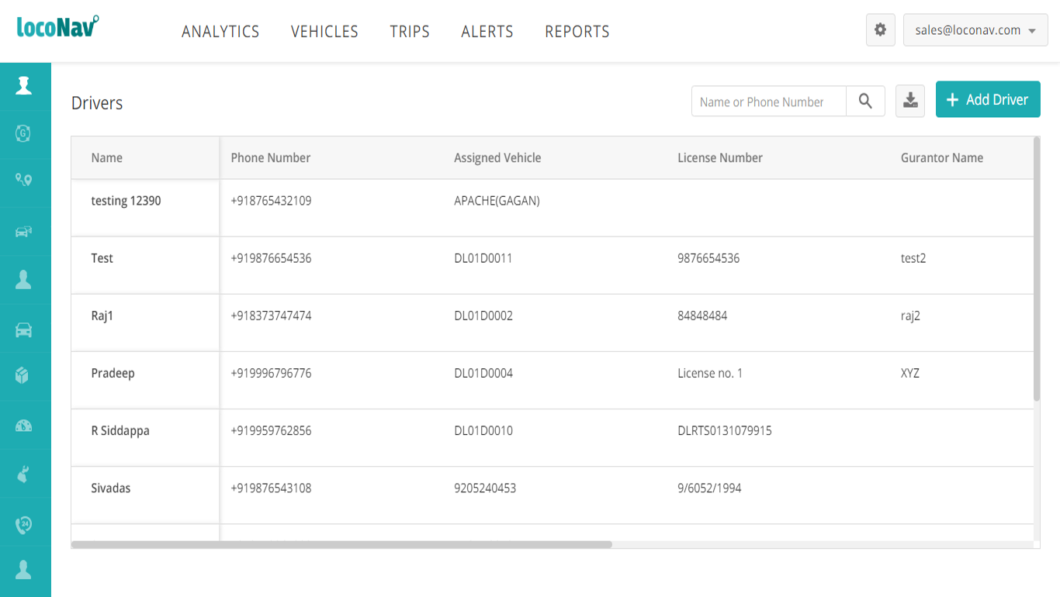
Managing Drivers and Helpers Records
Assign various routes or vehicles to the respective drivers/ helpers and monitor the Driver’s behavior.

Slide 4

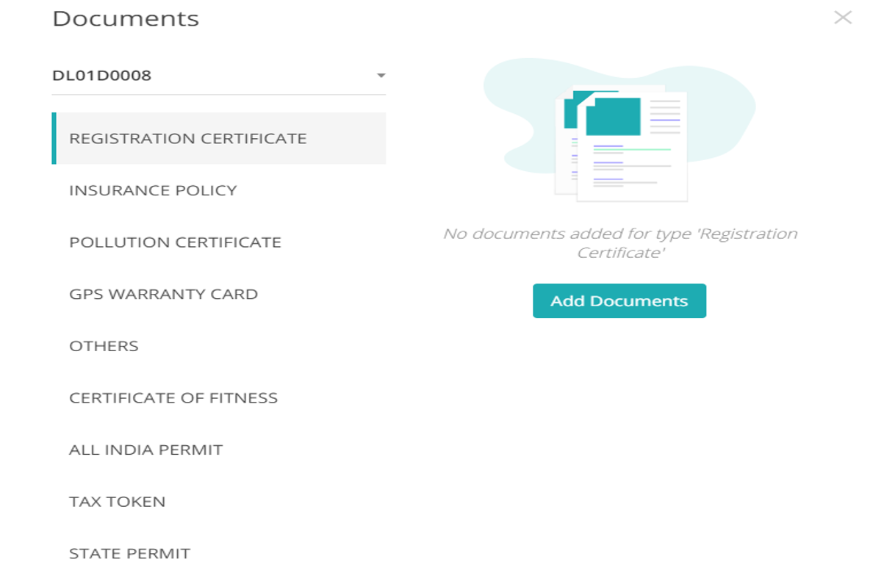
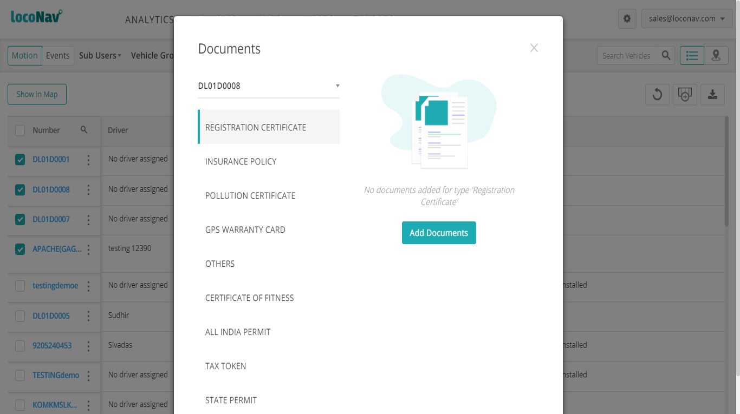
Managing Vehicles Records
Relevant documents related to the vehicles/ drivers can be uploaded
Notifications can be setup , prior to the expiration of the document’s validity
Cement

Slide 5

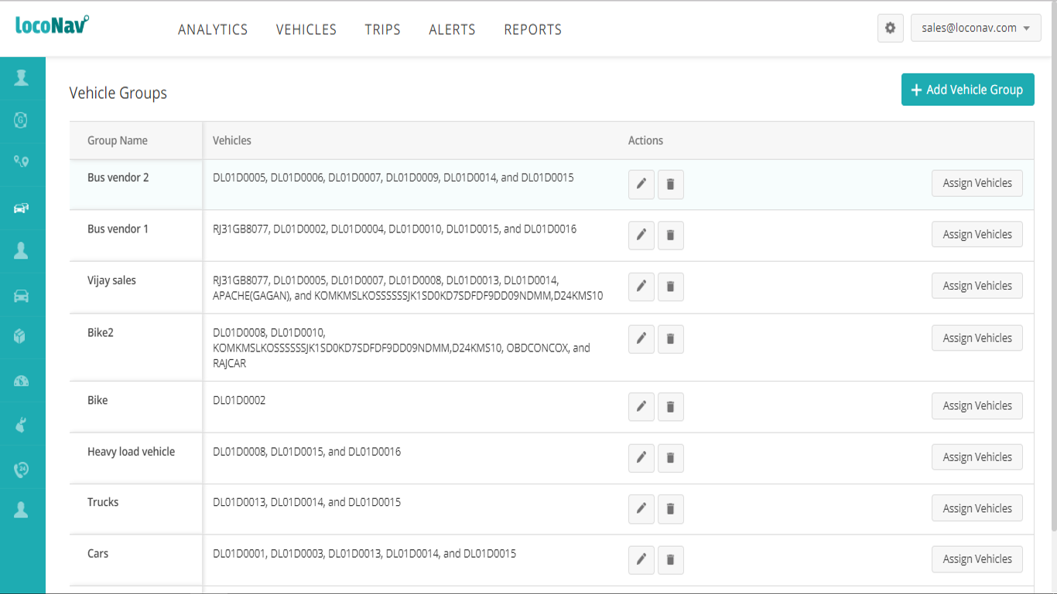
Managing Transporters
Group the vehicles based on the areas or categorize the transporters/ vendors.
Cement

Slide 6

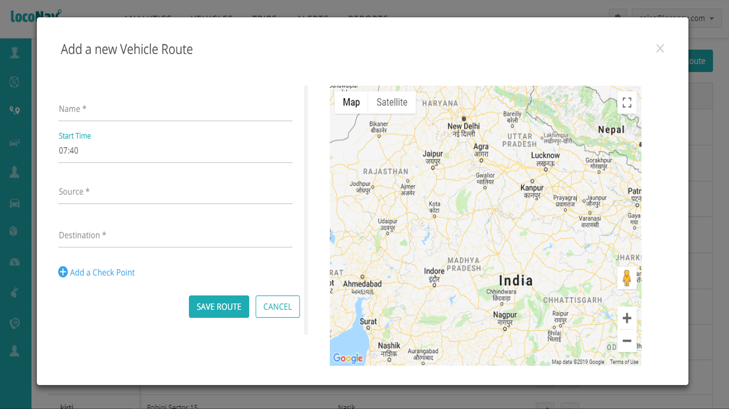
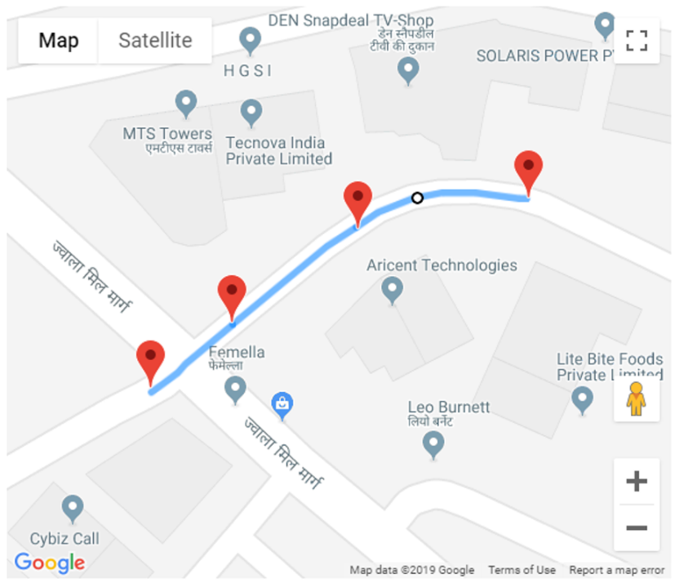
Managing Boarding Points and Routes
Set up routes and align various pick ups and drops.
Cement

Slide 7

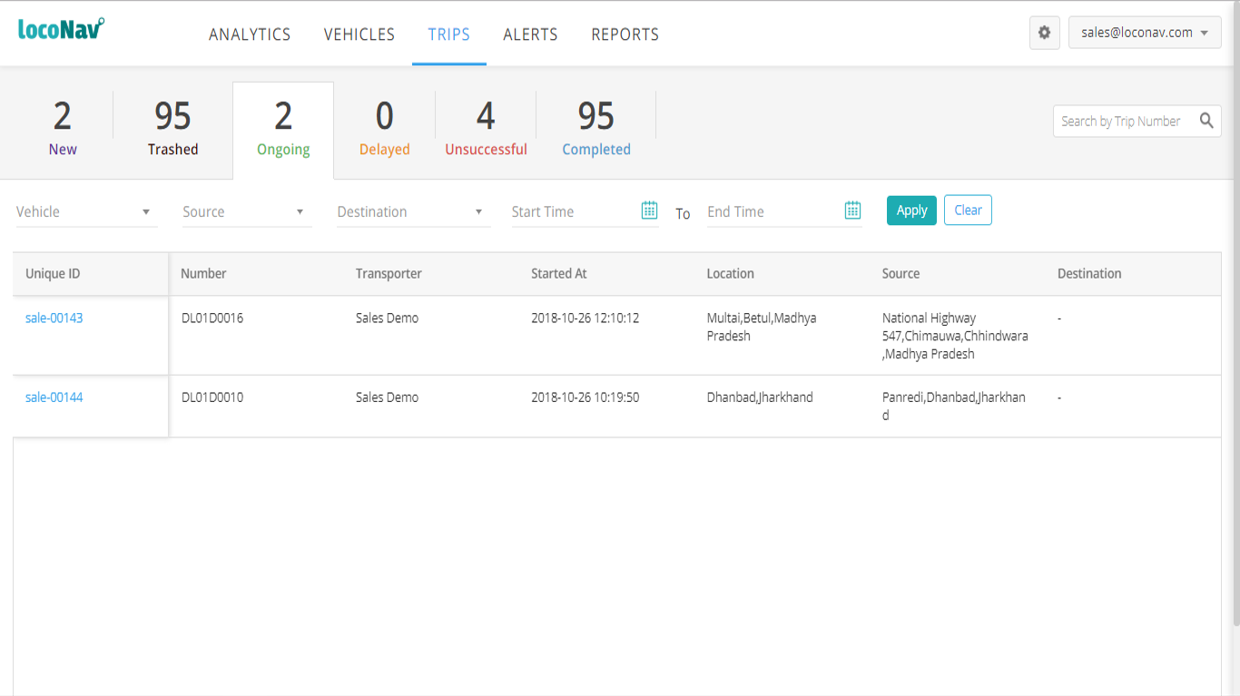
Daily Route Monitoring
Updated status of the vehicles along with real time reports and alerts.
Cement

Slide 8


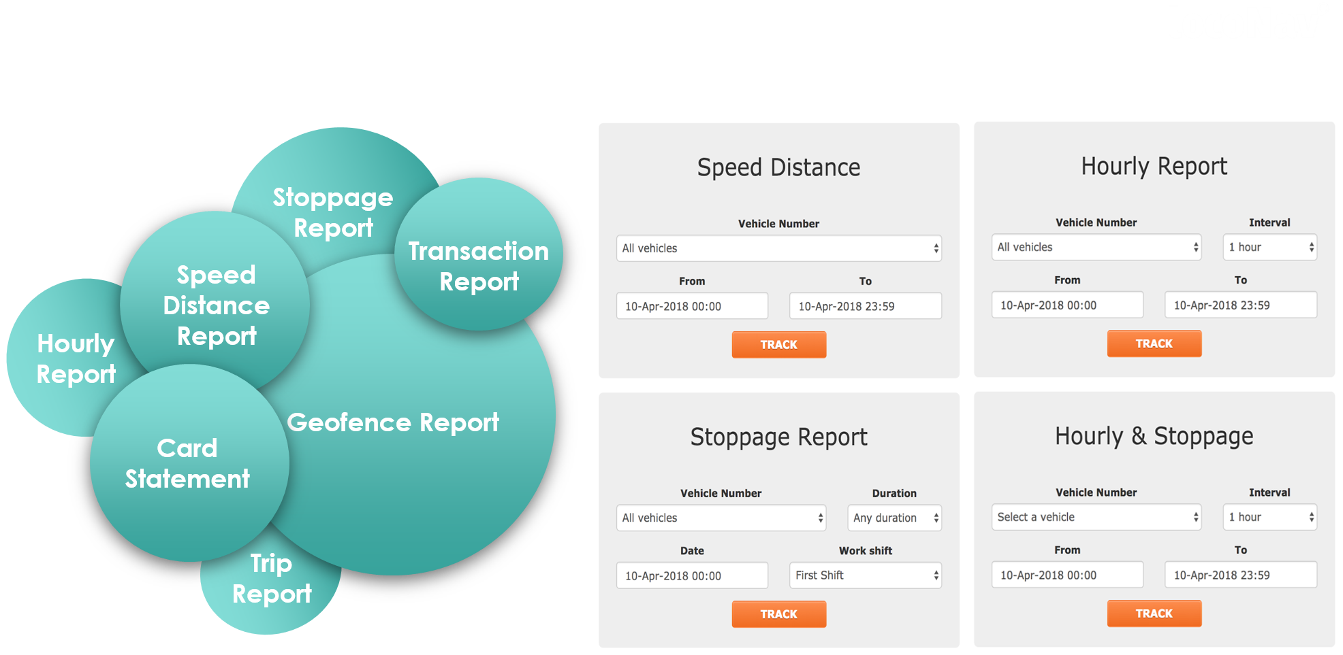
Reports & Alerts
Stoppage Report
Delay
Report
Speed Distance Report
Hourly Report
Geofence Report
Over speeding Report
Trip Report
Cement

Slide 9
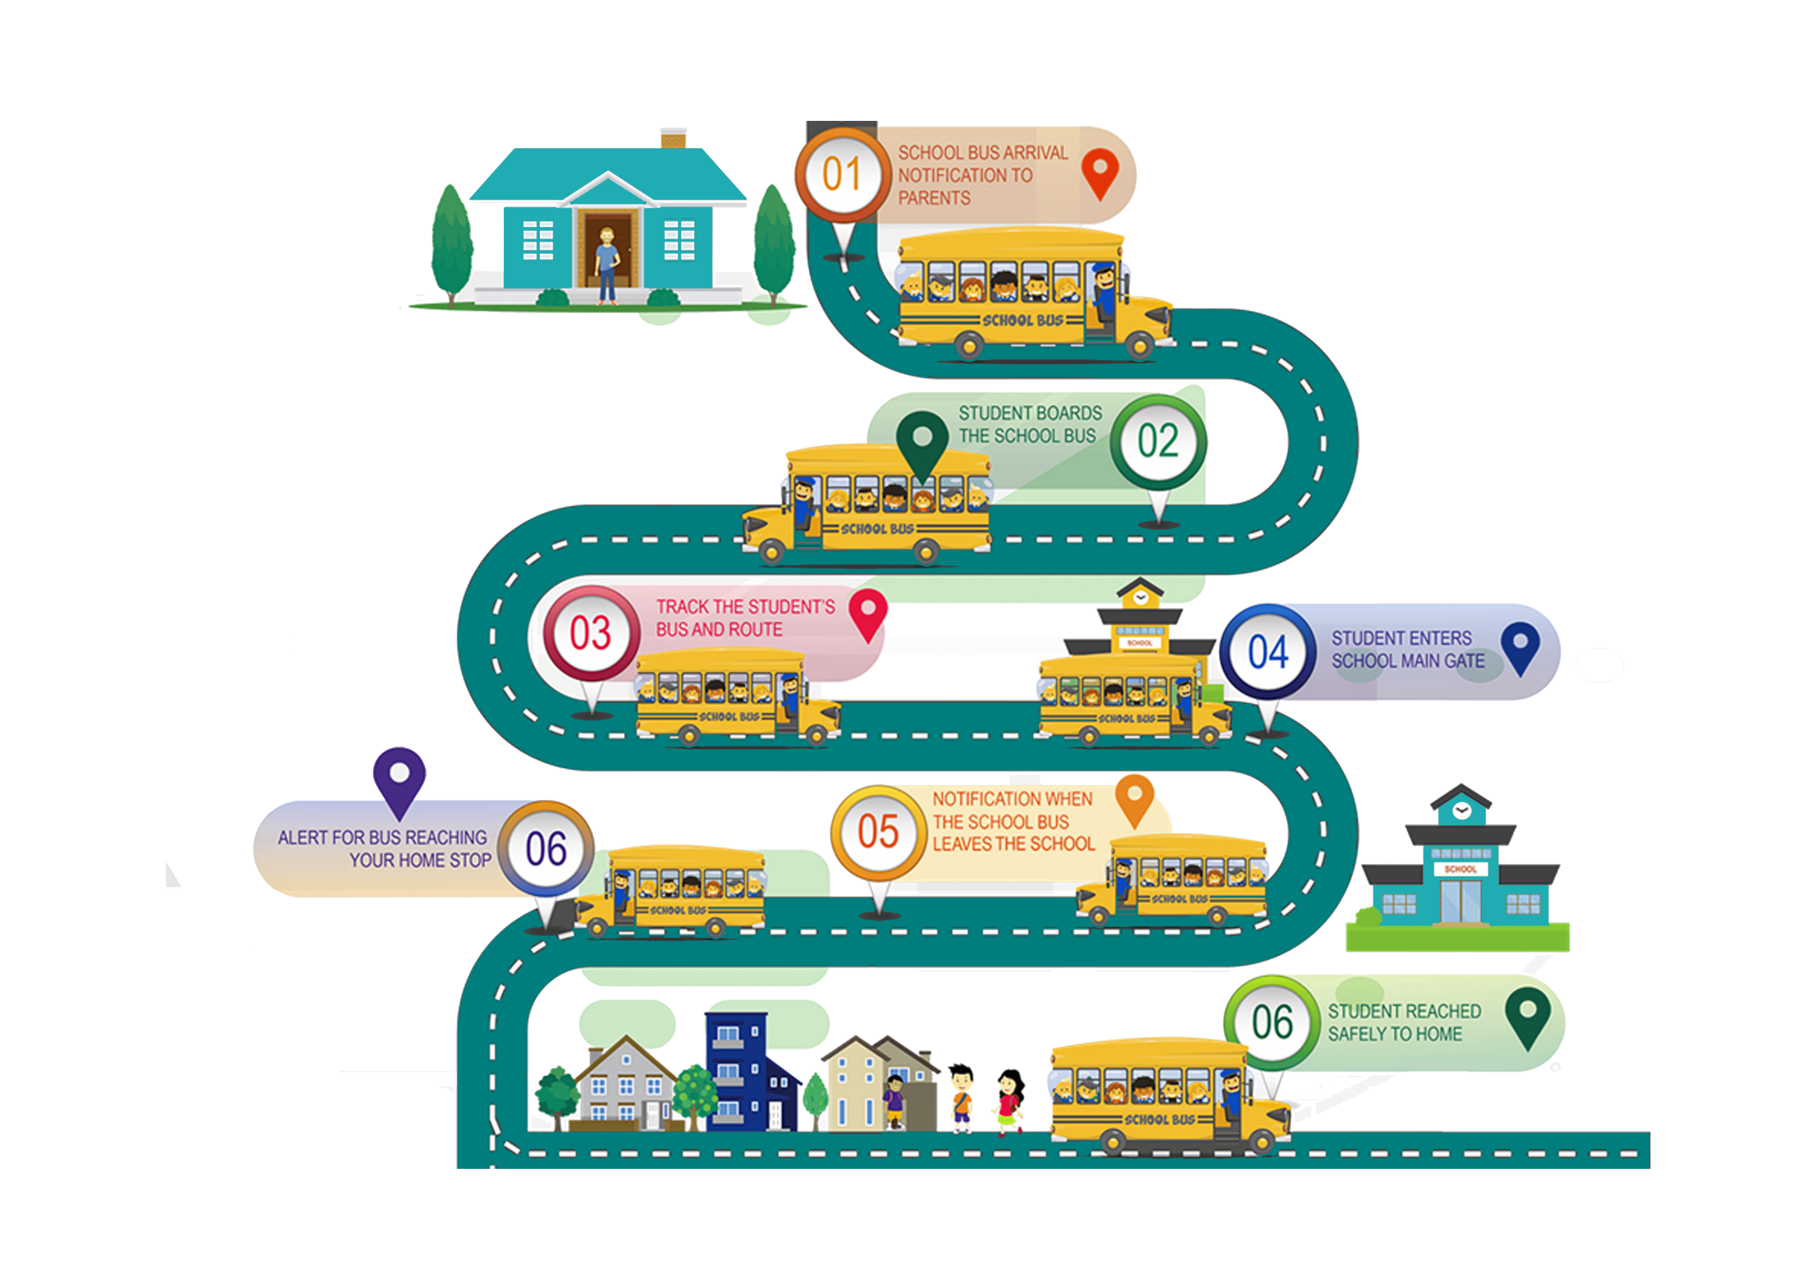
How it Works?

Slide 10



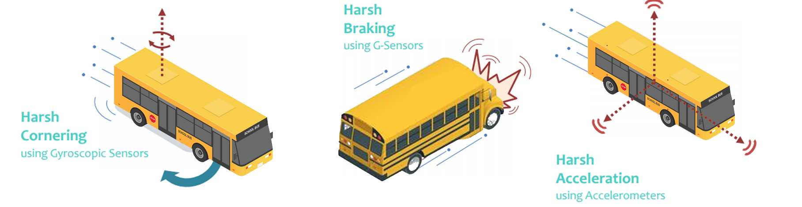
Safety and Compliance
AIS 140
AIS 140 approved GPS Tracking device with complete certifications and other offerings:
SOS/Panic buttons
To alert the respective authorities in case of any threat.
Over Speeding Alerts
To alert the respective authorities in case of any threat.
Immobilizer
Power to immobilize the vehicles from the dashboard.
Driver Behavior Monitoring
Driver rating based on Harsh Acceleration, Braking & Cornering with additional parameters like Stoppage Time, Continuous Driving.
Cement

Slide 11
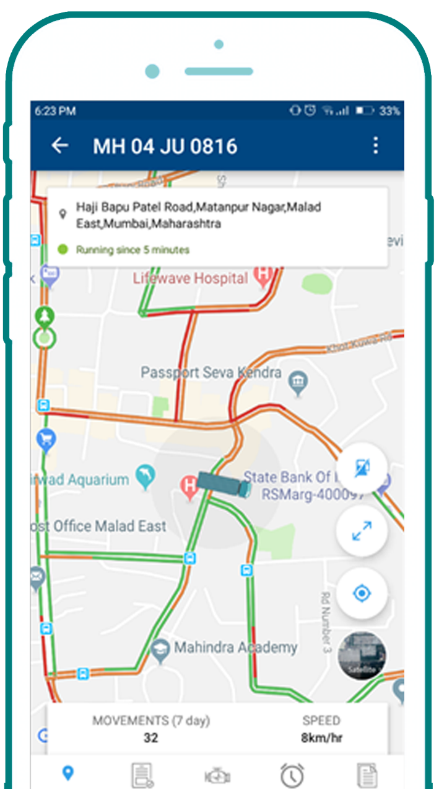
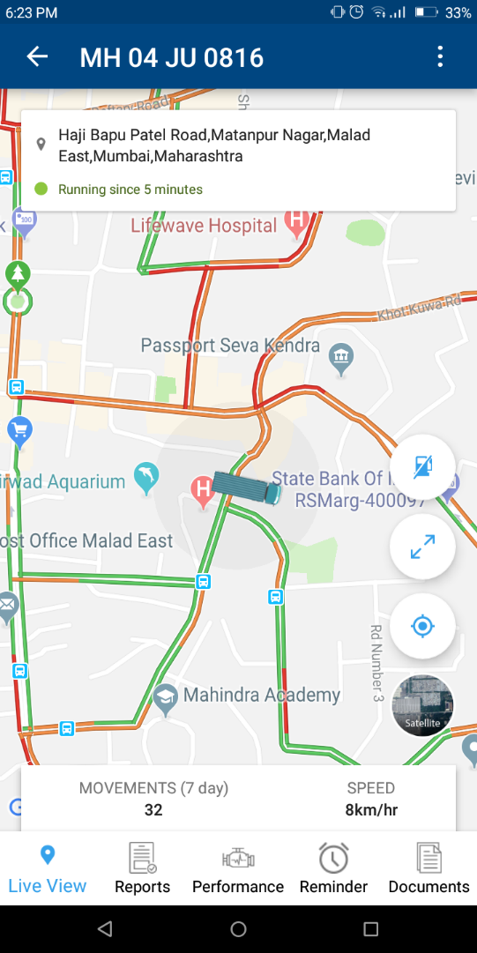
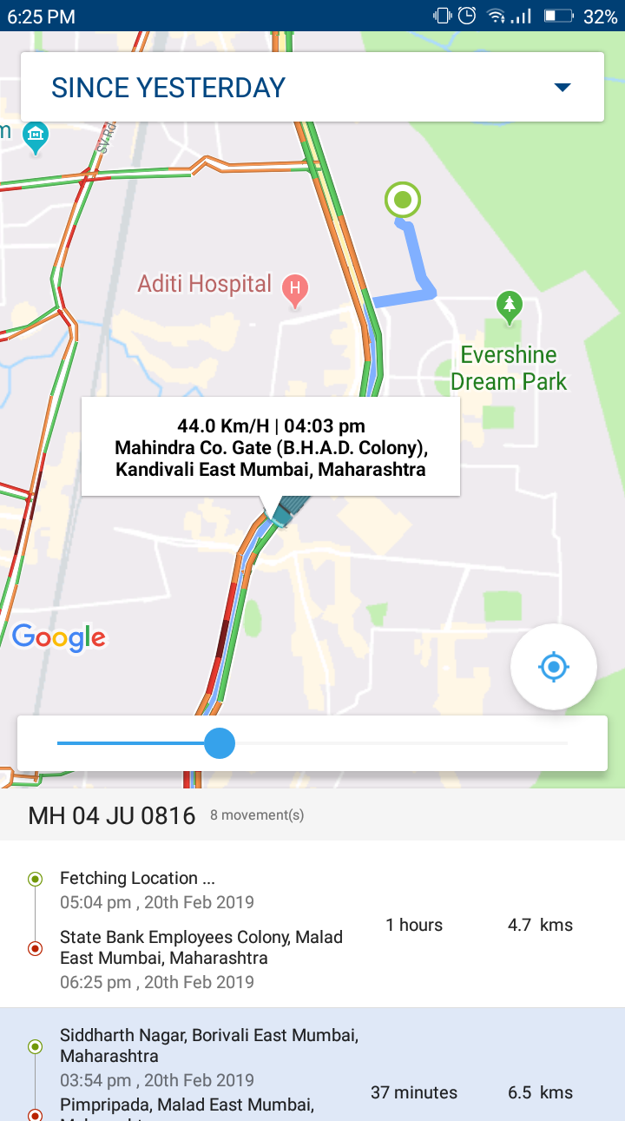

Real Time Tracking
Mobile App for tracking
Use TAU’s mobile app for tracking and controlling the vehicles remotely
Cement

Slide 12

Simple, fast & secure way to manage your vehicles
Thank You
Email: mo@tauholdingssa.co.za
Web: www.tauholdingssa.co.za
Phone: 087 700 7634

