Slide 1


Logistics Tracking and Management for
Cold Chain Industry
Simple, fast & secure way to manage your vehicles

Slide 2









About Us | Optimising Logistics Tracking and Management across Industries
Who Are We
Our USPs
Our Clientele
India's
leading logistics tracking platform
3000+ fleet owners
Nearly 1,70,000+
vehicles on platform
Backed by Sequoia Capital – one of the world’s largest tech venture fund
Best-in-class hardware with 98%+ uptime
Service and support network across 350+ locations
Client engagement by Business Consultants with Industry expertise
Robust and customizable software platform

Slide 3



Logistics in the Cold Chain Industry | Gaps and the Need for Tracking
Vendor Performance and Monitoring
Inbound Trucks
Supply
Empty Trucks
Transporter Fleet
Unloading time at Distributor or Customer
Distributor
Outbound Trucks
Customer
Unnecessary stoppages
Inefficient route planning
  No visibility of Shipment
  - No sense of ETA
- Lack of temperature control
Estimated time of delivery at Dealer/Customer
Waiting time at warehouse
-
-
-

Slide 4
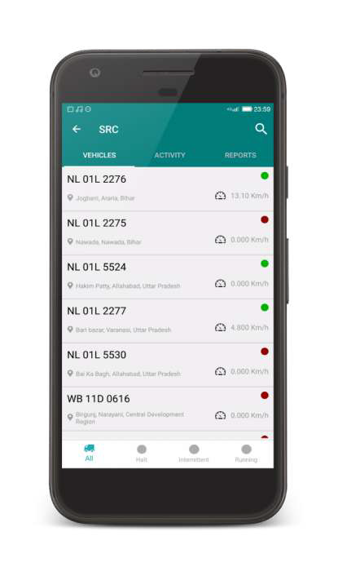
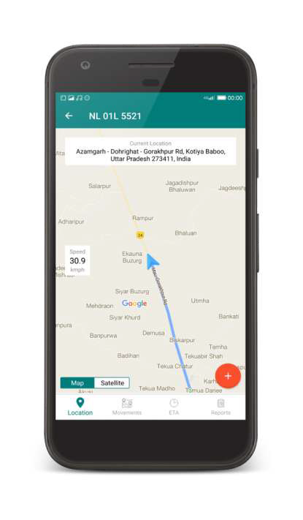
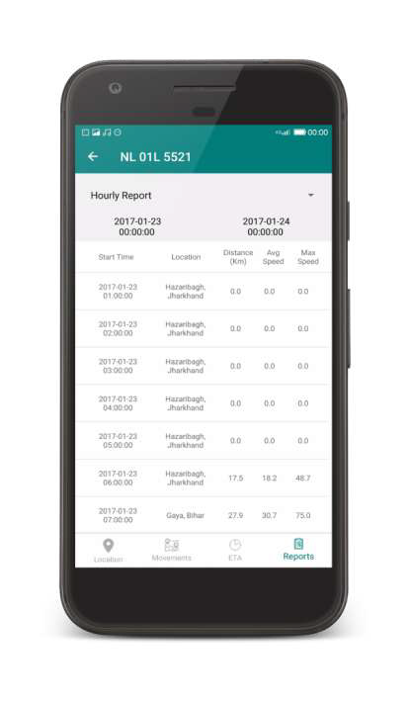




Our Solutions | Tracking and Analytics
Vehicle Tracking and Predictive ETA
Track Runtime and KMs travelled
  Stoppage/Idle Time
    Route Deviations
Predict delays and send
automated alerts to concerned stakeholders
Fleet Utilization
Track Idle time
Track fleet capacity utilization
View trip routes to identify &
prevent misuse
Identify bottlenecks in the supply
chain process
Geo-Fencing
Track Entry/Exit at a geo-fenced
location
Track turn-around-time from any A
to B location
Shipment Tracking
Way-point based Shipment
Tracking
Automated tracking of shipment
delivery to distributors

Slide 5
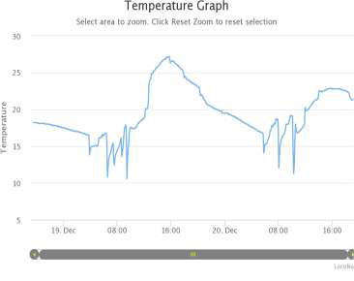
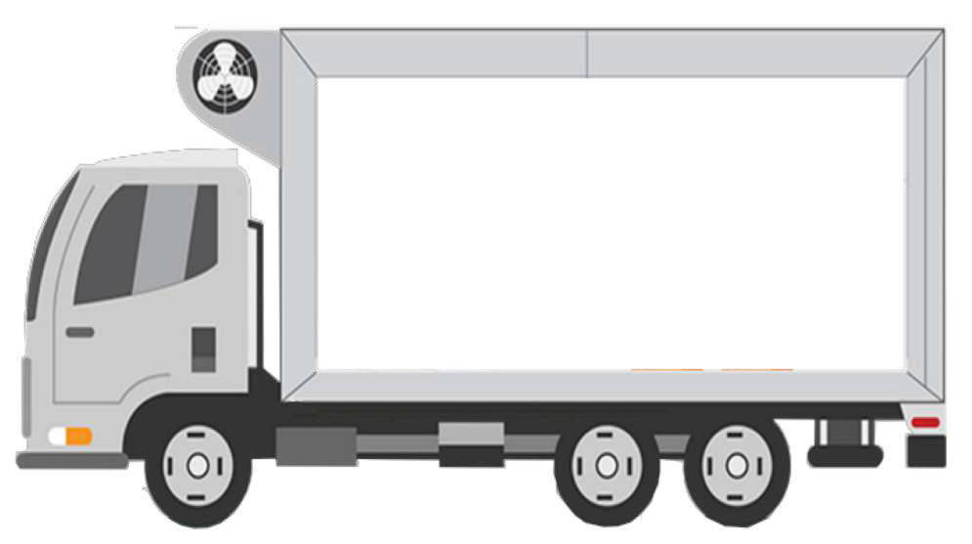


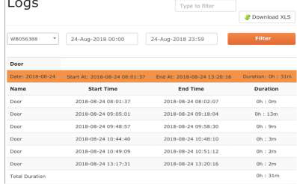
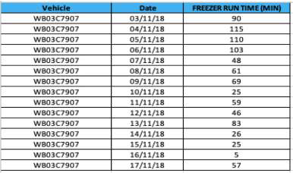
Our Solutions | Temperature Sensors - Normal
Temperature Sensor
High Quality Temp. IOT devices with Real Time Temp. Logs
  Temp. Exception Reports
  Downable Temp. Graphs
Freezer
Door Sensor
Temp. Sensor
Door Sensor
Real Time Door ON/OFF Alerts
  Door Sensing Log Report
GPS
Freezer Run Time
Freezer Run Time Report helping you in your monthly payouts

Slide 6
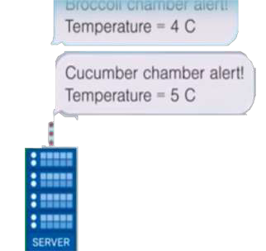
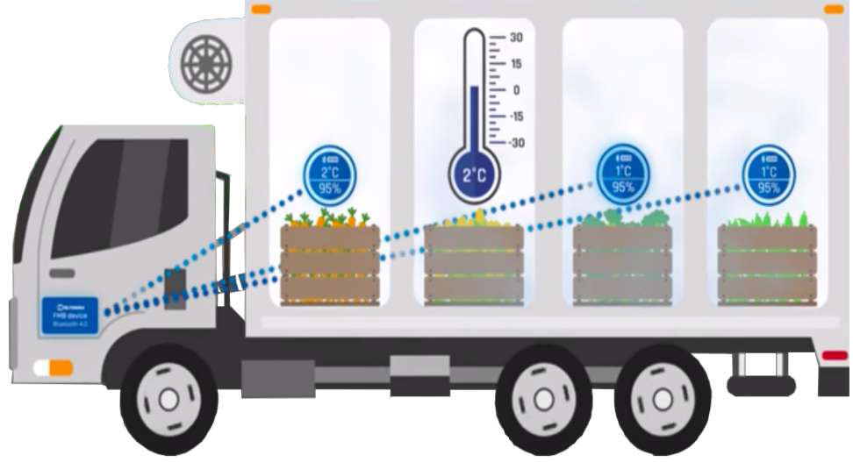
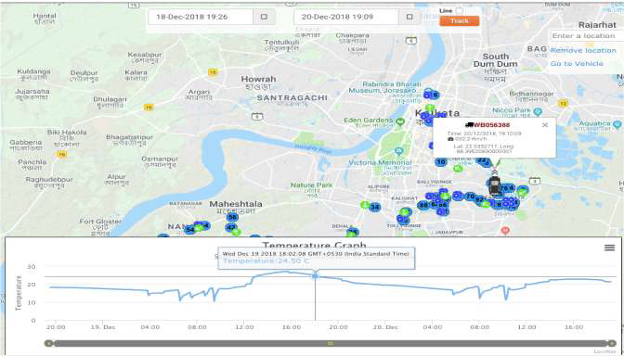
Our Solutions | Advanced Temperature Sensors - Bluetooth
Brocoli Chamber Alert Temperature 1° C
Cucumber Chamber Alert Temperature 2° C
Temp. Sensors
Bluetooth Temperature Sensors
Real Time temp logs for multiple chambers in a vehicle
simultaneously
  Magnetic Sensors which can be easily fixed to the inner rim of the
container without drilling.
Freezer
GPS

Slide 7


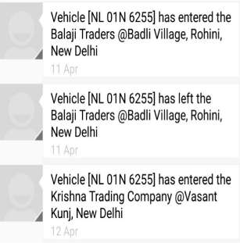

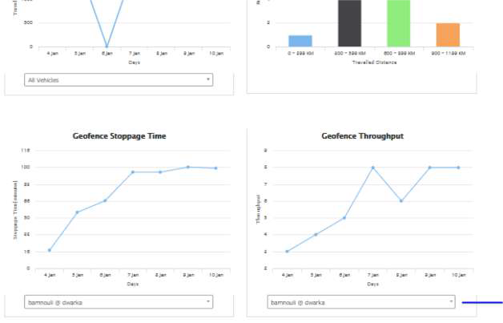
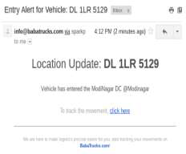


Our Solutions | Reporting, Alerts and Insights
Reporting
In-plant and Out-plant TAT reports
  Loading and Unloading time
reports
Waiting time at different zones and vehicle idle time reports
Track Vendor Performance
Vendor ratings based on TAT and utilization metrics
Ensure vendor SLAs are fulfilled
Alerts via SMS and Email
Entry and Exit alerts to concerned stakeholders when vehicle enters
or leaves a geo-fenced area
(Warehouse, Distributor, etc.)
  Alerts on idling and route deviation to prevent misuse
ERP Integration
Link movement data to existing
ERP
  Easier Vendor Reconciliation
Automated Compliance Checks

Slide 8





Success Stories | Key Customers
Grofers improved on its TAT by 20% by making data driven decisions on the basis of analytics available on LocoNav’s platform.
Loconav ensured that cases of tobacco pilferage and theft were reduced by 40%. Based on that initial success, they ensured that our solution was mandated for any transporter operating for them.
LocoNav’s platform helped Mio Amore monitor their daily movements, increase the efficiency in their truck movement by ~10% ,decrease misuse of vehicles, have greater transparency in the costs and identify pilferages.

Slide 9
Thank you
Email: mo@tauholdingssa.co.za
Web: www.tauholdingssa.co.za
Phone: 087 700 7634

