Slide 1










Logistics Tracking and Management
Global Logistics Show Award Winner: Best Supply Chain and Freight Visibility Software of the year
GPS Fleet
Management Platform
Real Time Tracking & Analytics
Expense Management System
Optimized Dashboard & Reporting
24/7 Service Across 300+ Locations
Proposal for
CEMENT INDUSTRIES

Slide 2



























Prestigious Clientele
Cement and Manufacturing
Fleets and Vehicle Aggregators
E-Comm, Retail and Others

Slide 3
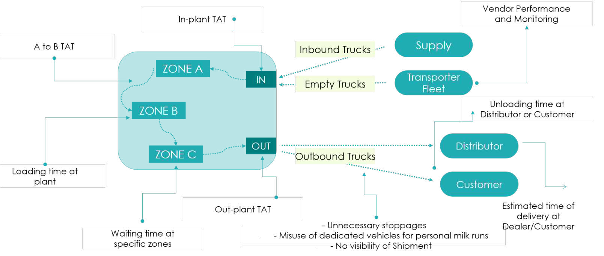
Logistics in the Cement Industry
Gaps and the Need for Tracking

Slide 4
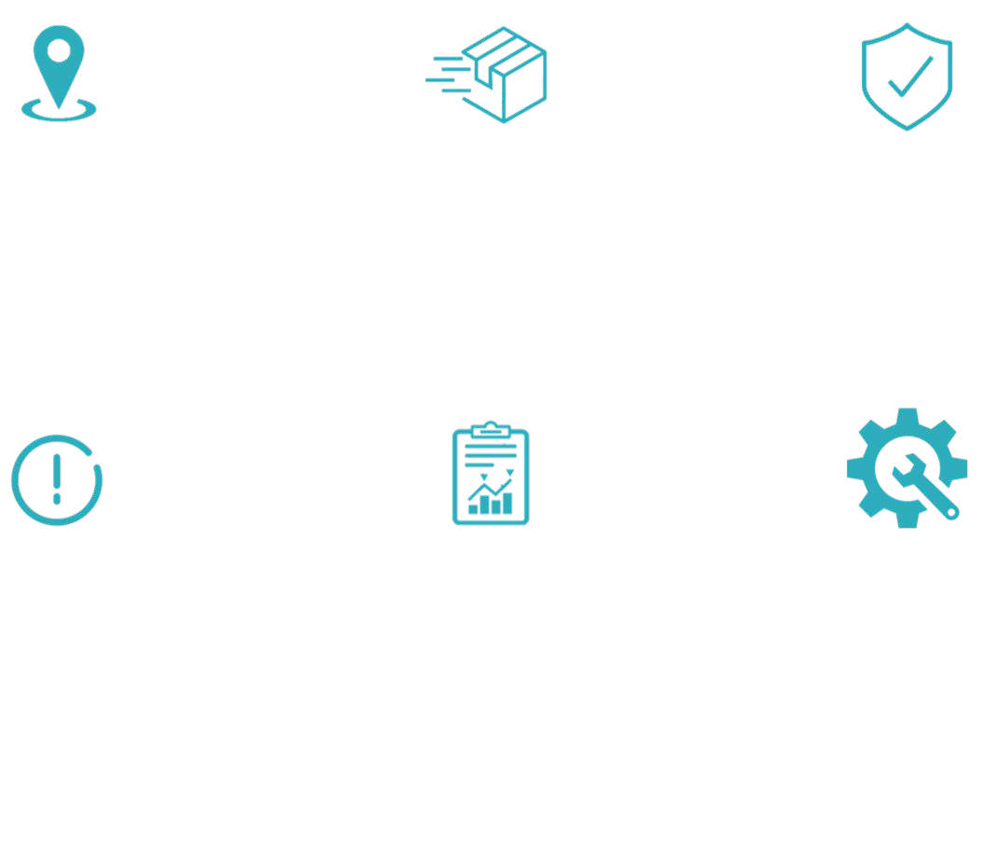

Features of Product
Live Asset Tracking
Shipment Tracking
Identify theft / pilferage
Have a bird-eye view on all assets that are plying for the company
Track Visibility of all outbound shipments via advanced tools & identify various statuses
With the help of our intelligent algorithms, track and identify the sources of pilferages
Real-time Alerts
Reporting
Expense Management
Get notified of various event types (Geofence Entry/Exit, Stoppages, Tampering, Delays, etc)
Identify the defaulters – The assets unavailable at the allotted spots during the prescribed times. Thus, minimize the inefficiencies
Control over drivers and vehicles Expenditure by monitoring
cash.
Also, Go Cashless

Slide 5


Optimization | Cost & Operations
Turn Around Time
Optimize both ‘In-Plant’ & Outbound movement using recursive analysis. Identify and take action against repetitive defaulters
Distance Correction
Create a repository of dealer locations & eliminate cases where the distances in the ERP system is leading to unnecessarily high payouts
Transporter Performance
Insightful reports & analysis on no. of trips undertaken and their statuses. Incentivize or penalize based on their performances to ensure a higher standard of operations
Dealer Performance
Identify dealer performance via reports generated using trip related metrics such as completed shipments, unsuccessful shipments, deviation, dealer detention etc.
Increased Trip Frequency
Provide visibility to dealers along with the ETA to ensure the detention time is reduced and thereby facilitate a quicker return to plant
Demand Forecasting
Daily report of vehicle status for precise planning to aid in increased serviceability to facilitate greater sales volumes and thereby capture a larger market share

Slide 6


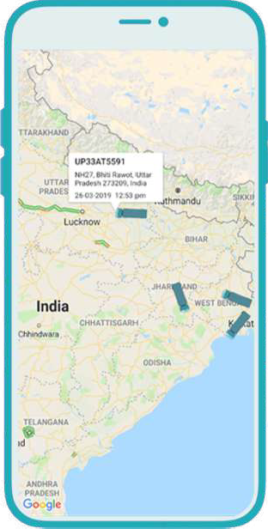

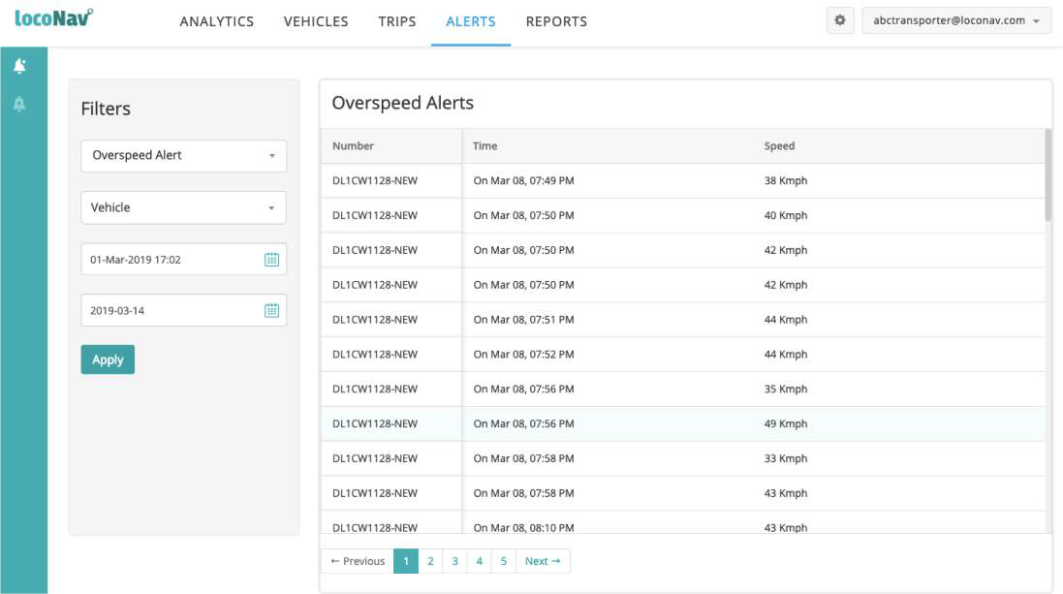
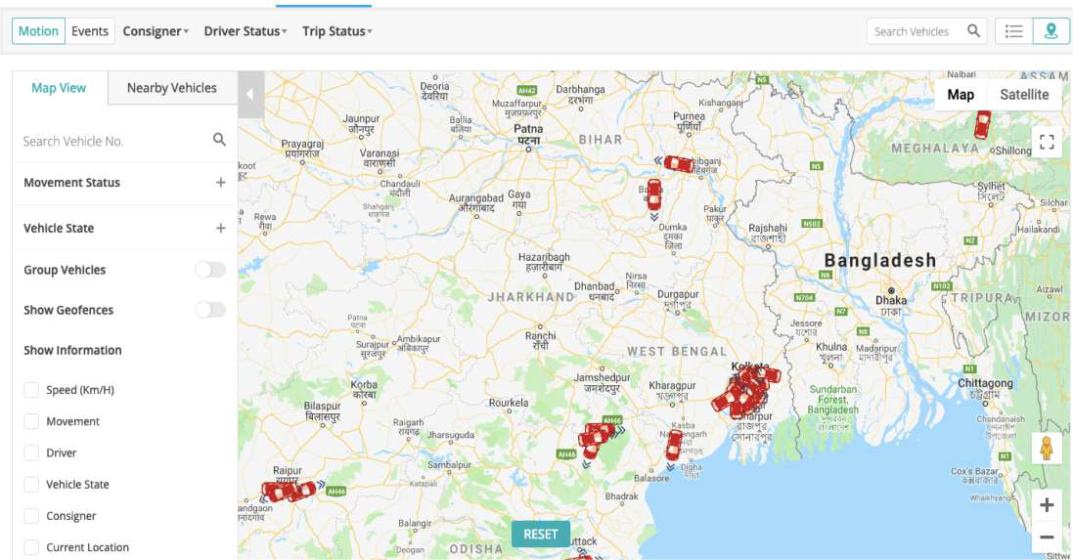
Live Tracking
Track movement of any particular vehicle
Have a hawk-eye view of the entire fleet
Analysis of the routes, traffic, idle times etc.
Customizable time and date settings

Slide 7


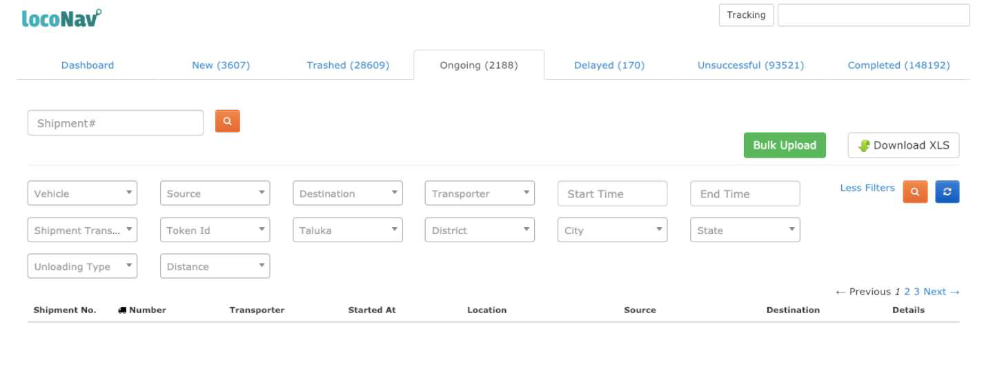
Shipment Tracking
Visibility of all outbound shipments equipped with intelligent algorithms to identify various states
NEW
TRASHED
ONGOING
DELAYED
UNSUCCESSFUL
COMPLETED

Slide 8



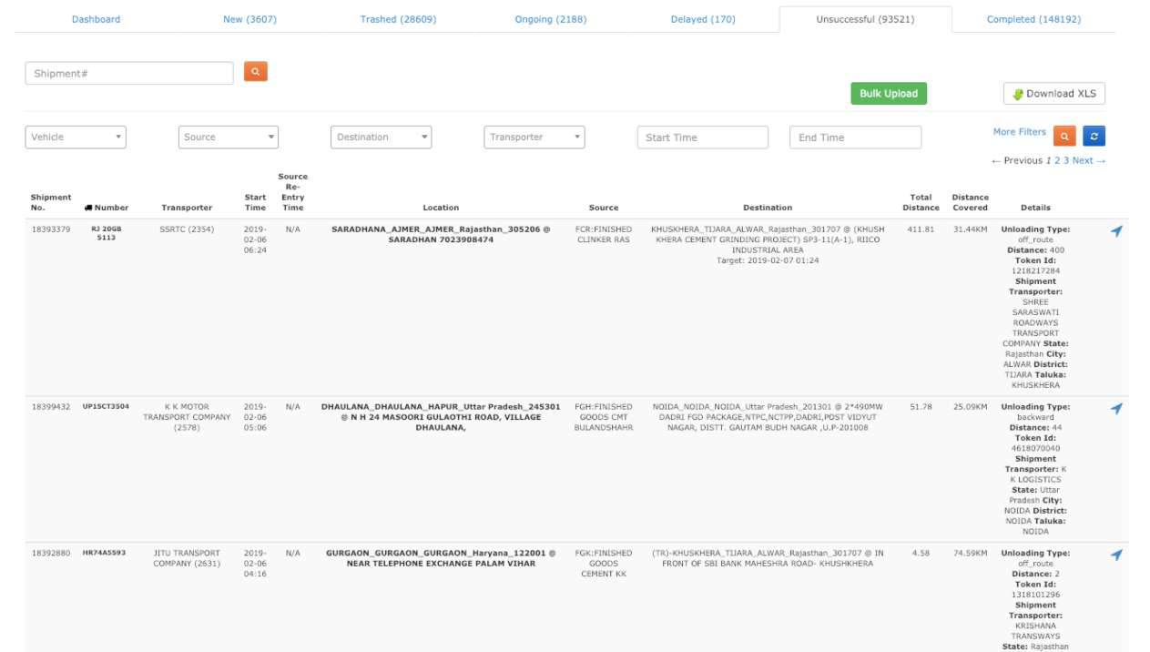
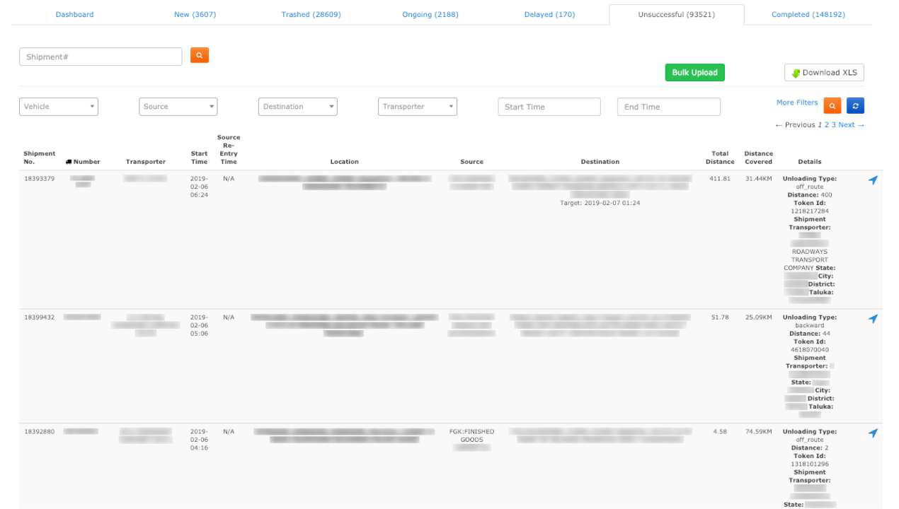

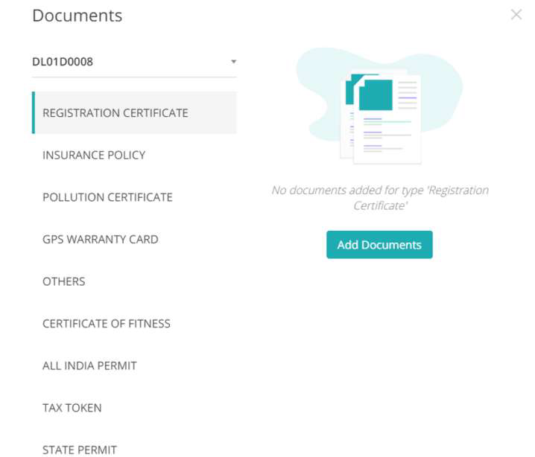
Identify Theft/Pilferage
With the help of our intelligent algorithms, track and identify the sources of pilferages
BACKLOADING
FORWARD UNLOADING
OFF-ROUTE
THEFT

Slide 9




Real Time Alerts
A log of all actions completed by a vehicle
Entry or exit alerts through a preset geofence,
Planned or unplanned stoppages during trips
Any attempts made for tampering the devices
Sort by alert type, vehicle no. or time period
Receive Alerts via web, app, SMS or e-mail

Slide 10

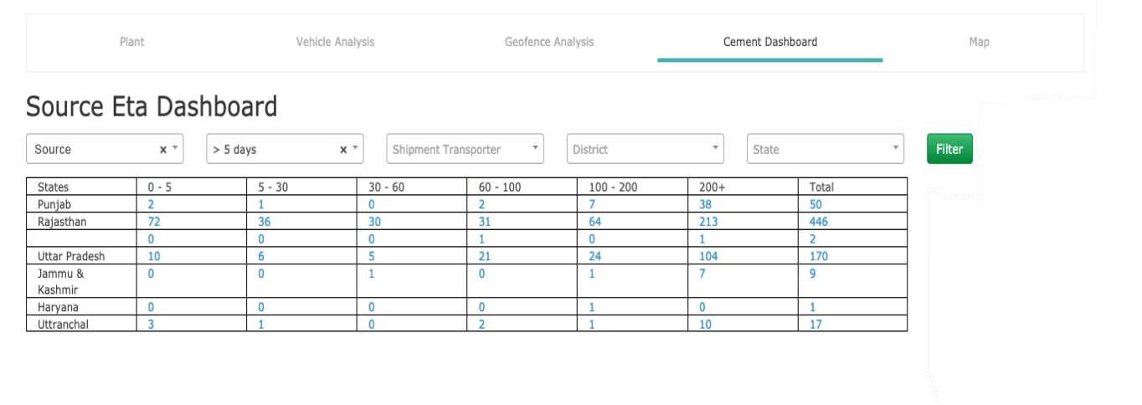

Empty Hauls - Load Forecasting
LocoNav's advanced load forecasting and predictive analysis dashboard helps Cement plants with complete visibility on shipment Forecasting. The Logistics team can plan, manage dispatch and shipment activities on the basis of this dashboard along with having a granular data on upcoming truck arrivals for respective plant locations.
ti f
The platform also has additional filters such as State/District, Transporter and others to easily locate the respective truck.

Slide 11

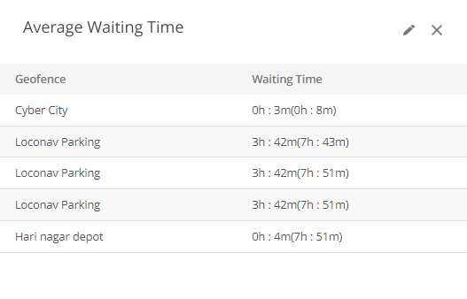
Reports and Analytics
rectify

Slide 12
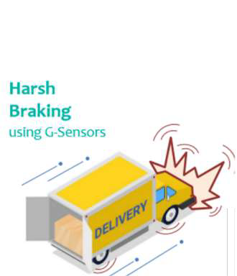

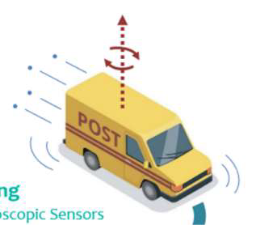
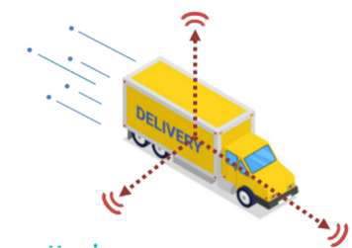


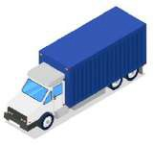
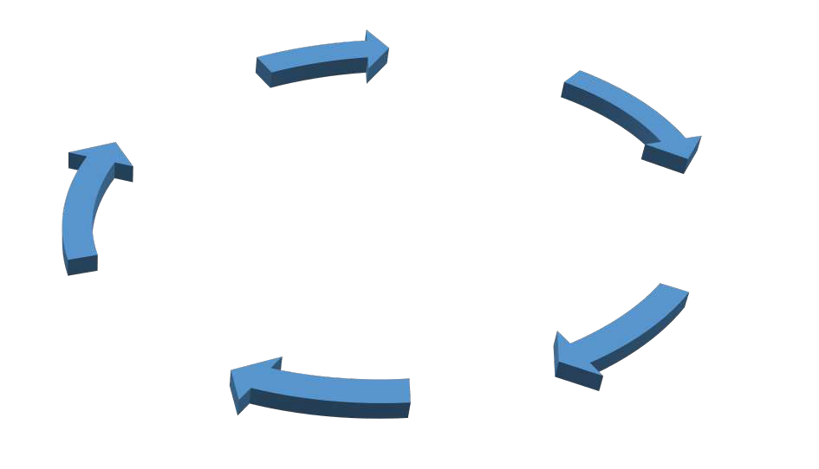





Driver Behavior Monitoring
Harsh Braking
Using G-Sensors
Harsh Cornering
Harsh Acceleration
Using Accelerometers
Using Gyroscopic Sensors
Driver rating based on Harsh Acceleration, Braking & Cornering with additional parameters like Stoppage Time, Continuous Driving.
Get real-time triggered events
Capture risky driving
Review, analyze, and score
Improve safety, reduce damage cost
Coach driver

Slide 13

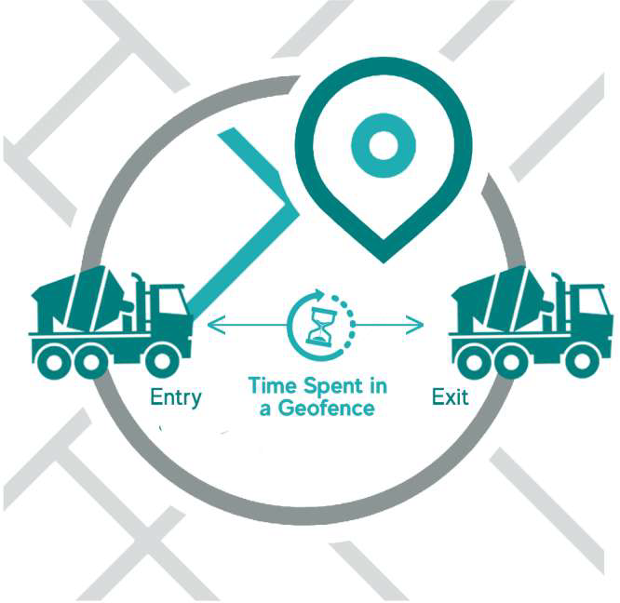
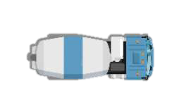


Reports | Increase Effectiveness & Identify Inefficiencies
Geofence Entry/ Exit Report
A report is created stating the entry and the exit timings of the vehicles in a particular region marked as a Geofence
The report helps in calculating the time taken for loading and unloading the cement and thus help in identifying the inefficiencies
The reports can be customized as per the requirements and the time intervals can be set as per the movements

Slide 14

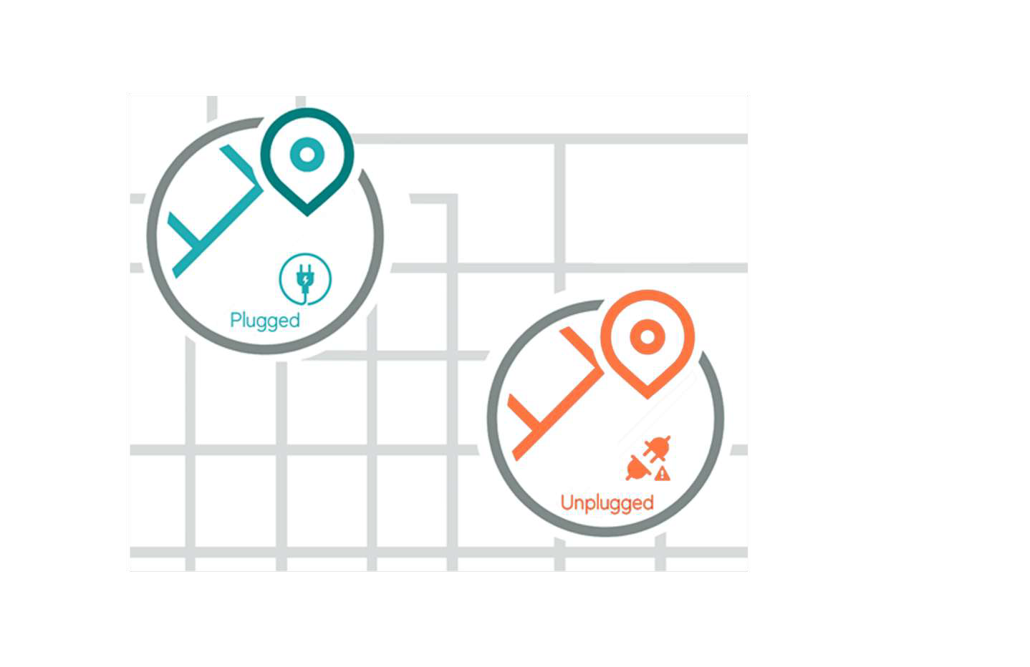

Reports | Increase Effectiveness & Identify Inefficiencies
Plugged / Unplugged Report
Reports are generated upon the plugging & the unplugging of the GPS devices specifying the timings and the location coordinates
An alert will be sent along with the details of the vehicle & the driver to the concerned authorities
The Alerts can be customized to be received via web, App, SMS or e- mail

Slide 15
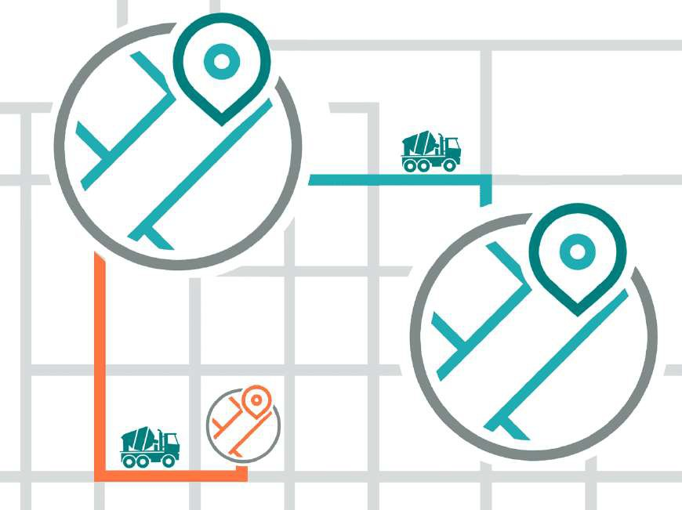
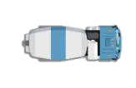

Reports | Increase Effectiveness & Identify Inefficiencies
Cluster Report
Customized report will be generated if any vehicle, during an assigned trip, is located at the coordinates which seem suspicious
Ideal Route
The suspicious areas could be the frequent stoppage locations, or the location of a dealer/ warehouse or plant of the competitors
Suspicious Location
The areas are mapped through Artificial Intelligence & Machine Learning using recursive analysis

Slide 16

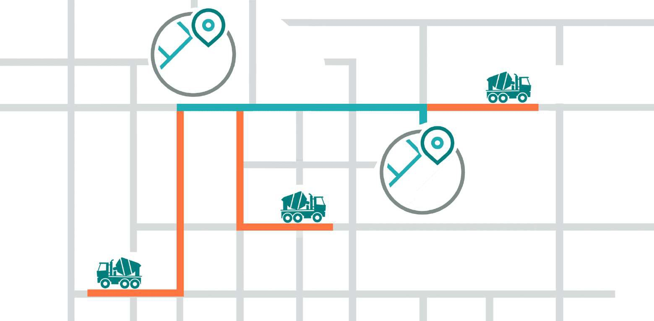
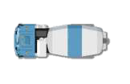
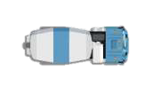

Reports | Increase Effectiveness & Identify Inefficiencies
Unsuccessful Shipment Report
Forward Unloading
Intelligent algorithms identify the transporters unloading cement farther away from the location
Source
Off-route
Destination
Machine Learning enables monitoring
the deviations/ off-routes
Backloading
Analytically driven solutions can help in sourcing the origin of backloading

Slide 17
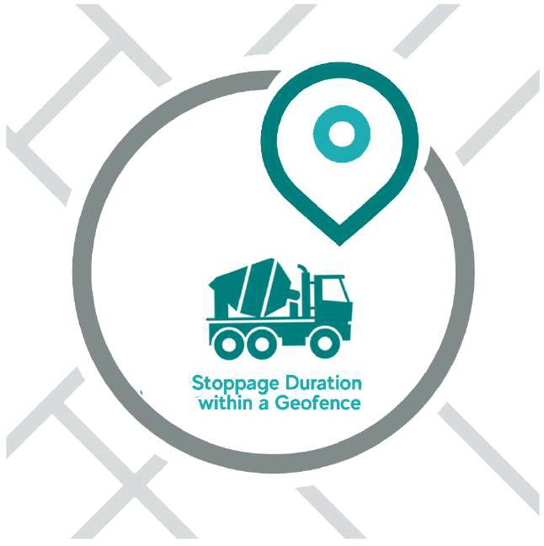
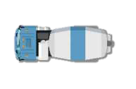
Reports | Increase Effectiveness & Identify Inefficiencies
Geofence Stoppage Report
The Geofence Stoppage Report displays a record of the time durations and the locations of various planned/ unplanned stoppages
The locations can be determined manually using our advanced tools on the platform or through integration with your existing ERPs & systems
The reports can be customized as per the requirements and time durations can be set as per the movement of the vehicles

Slide 18
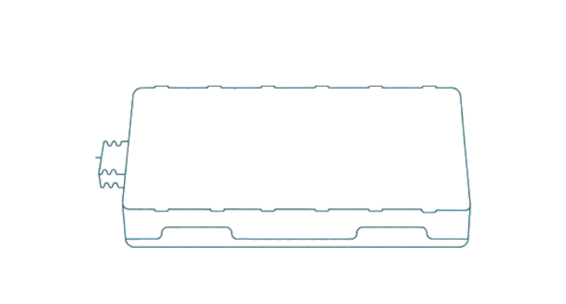











Devices & Specifications
Advanced Fixed Tracking
Internal Memory
Save data in low-connectivity zone
& upload when connection restores
ACC detection for ignition status
The ignition status along with the time duration can be recorded
Vehicle battery protection
Never drain out the battery of the vehicle for optimal protection
Tamper alert
Once the device is disassembled, you
will get informed immediately
Tracked by : SMS, APP, Web
Reports location in real time through
different interfaces
9-90V voltage range
Wide operating voltage applicable to all types of vehicles
Configurable tracking modes
Location uploaded following fixed distance, time interval, preset cornering
Remote power cut-off
Compel the vehicle to stop by breaking off the fuel connection

Slide 19

Implementation
Mandate
We recommend that a mandate be pushed towards the transporters for a seamless transition.
Dedicated installers
Service technicians will be deployed at the plant for an expedited installation process
Installation Capacity
Each installer on an average can install 5 – 10 devices on a daily basis
Dedicated KAM
A Key Account Manager will be assigned for all coordination pertaining to implementation

Slide 20



Success Stories | Shree Cements
“
Client wanted to gain visibility of all movements & understand the root-cause of sub-optimal logistics movement which led to high operational costs
Shree Cement
increased visibility,
LocoNav provided state-of-art telematics solution for the entire fleet
optimized TAT & reduced
”
Visibility of all consignments increased by more than 50%
pilferages
Integrated with their internal ERP system for automated shipment tracking
Have market leading In-Plant TAT

Slide 21
Profitability | Increased Revenue & Cost Savings
LocoNav’s platform has helped clients in both, increasing productivity as well as saving costs.
Increased Revenue
Improved in-plant/out-plant TAT and faster return of vehicles to the plants, helped our clients to increase their productivity by 20%
Explanation:
Initially, on an avg. our clients could only cater to 200- 210 trucks/day and produce 8000 tons/day. Now with a better TAT, reduced detention time at the dealer location, faster return of the trucks & availability of the trucks at the plant, the production per day has been increased to 10,000 ton/per day catering 280-300 trucks/ day.
Cost Savings
Identified and corrected cases of Deviations, Back-Loadings, Unwanted stoppages, Suspicious Locations helped our clients save up to 15% of their expenditures
Explanation:
Our client identified cases of mis-selling low quality cement in a price-hiked zone and saved up- to INR 40000 - 50000 per case accounting to 5-10% pilferage saving.
Multiple backloading, forward loading, off route cases were identified and corrected, saving up-to
25% in their freight cost.

Slide 22



Success Stories | Key Clients in Cement & Manufacturing
We managed KJS cement’s prime cement plant, and set up a logistic shipment control room to track and monitor
shipments in real time bringing down pilferages by 10%.
LocoNav helped ITC in getting a Hawk Eye view of all the logistics operations going on at different sites such as Manufacturing Unit, Warehouse, Distributor/CnF Agents.
Ambuja Cements improved on its in-plant TAT, a 20%
reduction, by making data driven decisions on the basis of analytics available on LocoNav’s platform.

Slide 23

Thank you
Email: mo@tauholdingssa.co.za
Web: www.tauholdingssa.co.za
Phone: 087 700 7634

